Slide 1
Corrections for Electric Field and Pitch
D. Rubin for the Efield/Pitch team
and thanks to Josh, Tyler, Renee, James, David T., Antoine, and Paul for slides and explanations
July 15, 2020

Slide 2
Electric field and vertical pitching motion systematically shift ω_{a}
How do we determine that shift ?
Origin of Efield and pitch contributions
Approximate Formulation – How do we quantify the effects?
g-2 Ring model dependent uncertainties
Measurement
  Methods
  Results
  Uncertainties

Slide 3
What is the contribution of electric field and pitch to the measured precession frequency?
We measure the rate of change of the projection of the polarization on the velocity
Jackson
(11.171)
In a uniform field where and ,
z
ρ
φ
ρ
φ

Slide 4
B_{z}
Pitch is that component of velocity parallel to
φ
ρ
φ
How much is the frequency shifted due to the pitch?
z
φ

Slide 5
y₀
Pitch and ω_{a}
B_{y}
B_{z}
B_{z}
The vertical motion is modulated by the quad electric field
If there were no magnetic field, projection of polarization on velocity is constant
At the magic momentum
The out of horizontal plane component of follows the out of plane component of
Is always in the plane defined by and

Slide 6
Substitute the ‘unperturbed’ solution into our differential equation

Slide 7
z
φ
How do we measure ?
If motion (quad field) is linear
Average over all φ for a given amplitude a

Slide 8
Pitch
True in general for each muon
Assuming linear and continuous quads

Slide 9
True for any muon ?
Excellent agreement with ‘spin tracking’ (integrating BMT equation)
For any muon in a distribution we can compute to determine
the contribution of pitching motion to

Slide 10
What about our assumption of linear and continuous quads, in perfect alignment, with uniform voltage?
Test in simulation
For each of 1280 permutations of plate offsets and voltage errors, inject and track a distribution of muons
ΔV_{p} = ± 5% V₀
Quad plates
±1mm
Q1 S
Q1 L
Q2 S
Q2 L
Q3 S
Q3 L
Q4 S
Q4 L

Slide 11
Pitch and acceptance
The maximum pitch angle is determined by the physical aperture (collimators)
The average pitch correction for the distribution depends on the vertical acceptance of the detector
If aperture is 45mm then
Acceptance | C_{p} [ppm]
± 1 mm | -0.09
± 10 mm | -0.11
± 40 mm | -0.175

Slide 12
We measure vertical position. We prefer vertical amplitude
y
t
Time spent at each position
(same as decay distribution)
Next few slides courtesy J. Mott

Slide 13
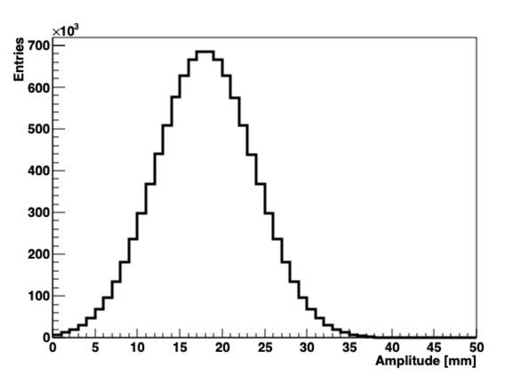
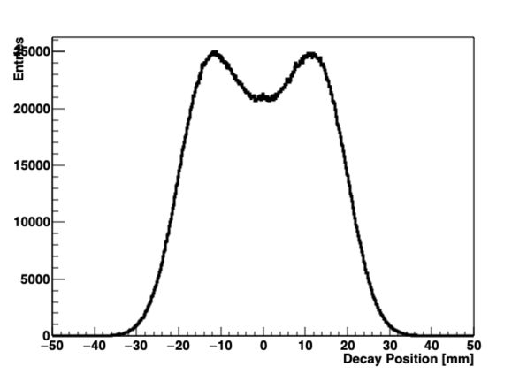
Toy MC: Amplitudes to Positions
Distribution of amplitudes
Distribution of measured positions
Suppose we have a distribution of amplitudes
The left plot is the natural one to get the pitch correction
The right plot is what we would measure in the tracker (assuming we do all our acceptance/resolution corrections right)

Slide 14
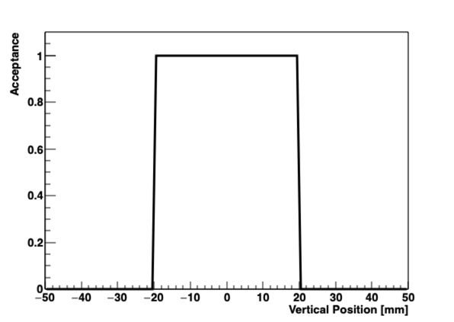
Toy MC: Simple Calo Acceptance
Suppose this box function defines the calo acceptance

Slide 15
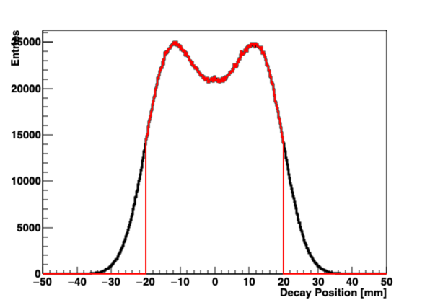
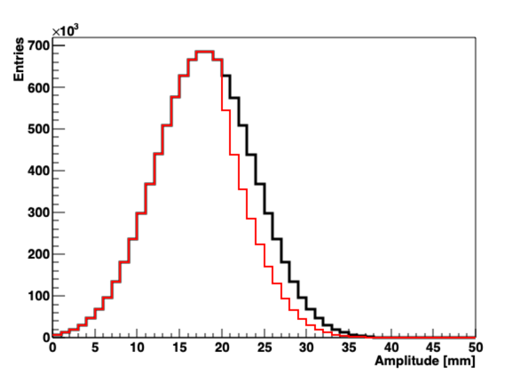
Toy MC: Simple Calo Acceptance
Imagine a calo acceptance of +/- 20 mm
Measured position distribution
Amplitude distribution
C_{p} = 191 ppb
C_{p} = 135 ppb
Beam
Calo Measured
C_{p} = 191 ppb
C_{p} = 170 ppb
<y²> underestimates angles and C_{p}
<a> accounts for all angles

Slide 16
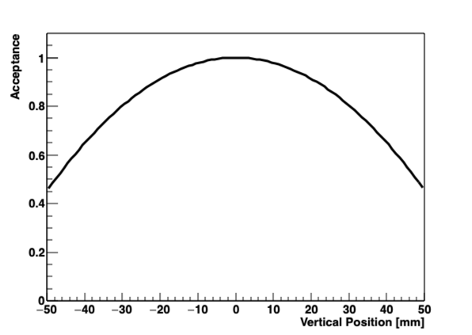
Toy MC: Realistic Calo Acceptance
More realistic calo acceptance:
Uses gm2ringsim (gas gun) and E > 1700 MeV. All the calos combined.

Slide 17
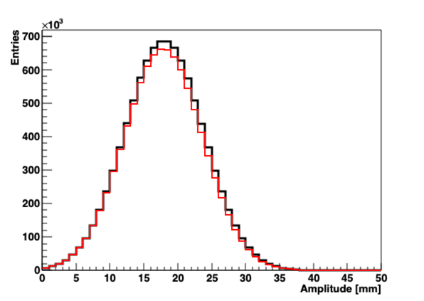
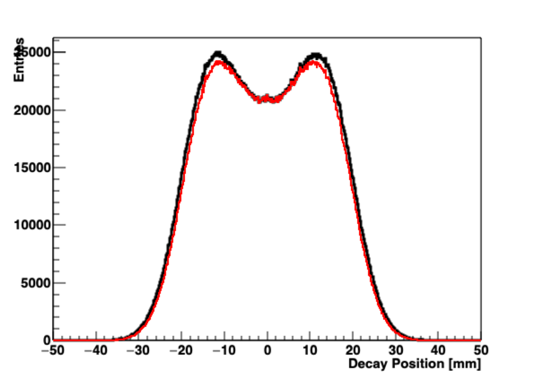
Toy MC: Realistic Calo Acceptance
Effect is the same as before, but more subtle.
In this made up toy MC case, we’re only off by 5 ppb
Beam
Calo Measured
C_{p} = 191 ppb
C_{p} = 188 ppb
C_{p} = 191 ppb
C_{p} = 183 ppb
This is right
This is wrong
<a> accounts for all angles
<y²> underestimates angles and C_{p}

Slide 18
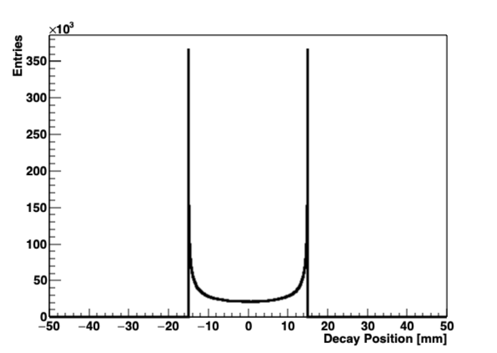
Calo Acceptance & Weighting
If we have a betatron amplitude, we can calculate its appropriate weighting based on the calo acceptance maps
We just need to multiply the two distributions together to get how often the muon decays as seen by calos:
⊗

Slide 19
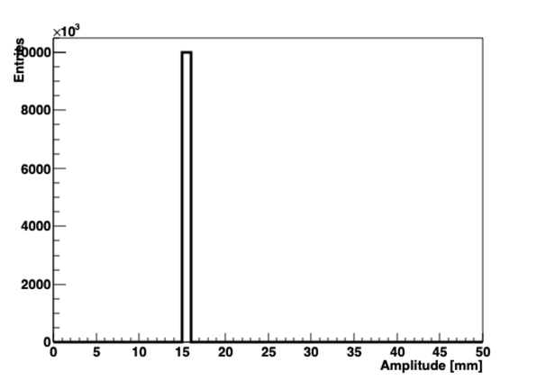
For any given betatron amplitude, A, we can compute probability of measuring
a particular position y

Slide 20
Single amplitude
Distribution of amplitudes
Amplitude distribution
Position distribution
Probability that amplitude lands at position is
If there are entries in amplitude bin then there will be entries in position bin
Summing over amplitude bins

Slide 21
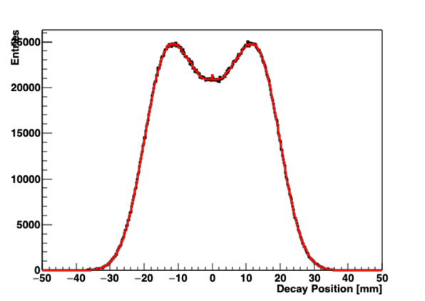
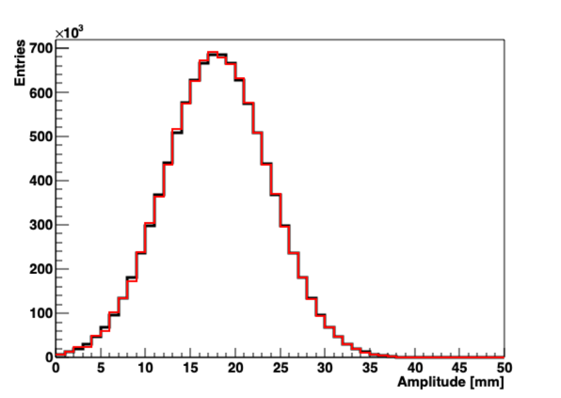
We want to determine the number of entries in each amplitude bin based on the number of entries in position bins
Measure . Compute . And minimize to determine
Works just great with Toy MC
Input
Fit

Slide 22
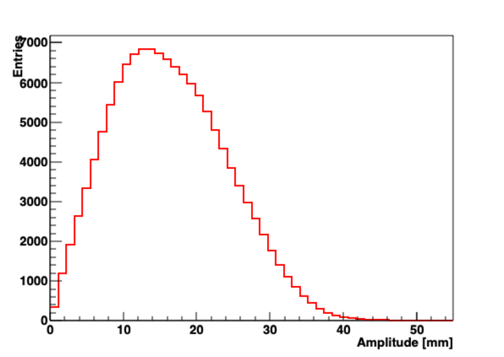
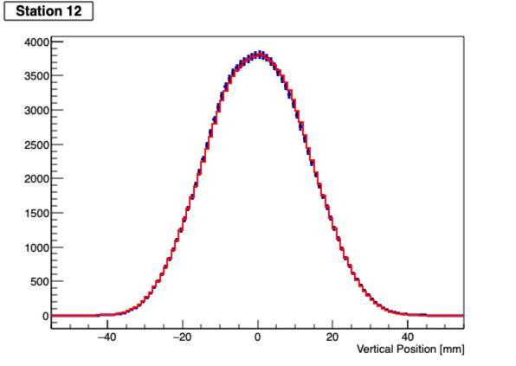
Data: Amplitude Extraction in Action
Run 15922: Station 12
Data
Fit
Looks reasonable, and also a small effect
C_{p} = 176 ppb
C_{p} = 177 ppb
C_{p} = 176 ppb

Slide 23
Run 1
Tracker S12
Raw positions – corrected for tracker resolution and acceptance
Fit amplitudes –
Fit positions – based on fitted amplitudes

Slide 24
Run 1 tracker S18
Raw positions – corrected for tracker resolution and acceptance
Fit amplitudes –
Fit positions – based on fitted amplitudes

Slide 25
Convert from position to amplitude space to properly account for angular acceptance
Next steps
Station by station acceptance correction
Modulation of β –function around the ring
Apply calo acceptance to ‘measured’ amplitude distribution
Determine systematic model dependent uncertainty
Fit vertical frequency to measure vertical tune to get n
Estimates
Preliminary

Slide 26
Efield correction
(11.171)
Substitution of our ‘unperturbed’ solution gives us
True for each muon
Assuming continuous linear quad fields
Assuming linear and continuous quads

Slide 27
True for any muon ?
*
*(No vertical motion)
Excellent agreement with ‘spin tracking’ (integrating BMT equation)

Slide 28
What about our assumption of linear and continuous quads, in perfect alignment, with uniform voltage?
For each of 1280 permutations of plate offsets and voltage errors, inject and track a distribution of muons
Test in simulation
ΔV_{p} = ± 5% V₀
Quad plates
±1mm
Q1 S
Q1 L
Q2 S
Q2 L
Q3 S
Q3 L
Q4 S
Q4 L

Slide 29
Contribution to from E-field
Measurement of radial closed orbit, => E-field correction
The revolution frequency is related to as
Fourier method: Measure frequency distribution of the ‘Fast Rotation’ signal
‘Fast Rotation’ signal is all calo hits vs time above threshold
t

Slide 30
Suppose a single momentum is circulating in the ring, forward and backward in time
from to
Then is a Dirac comb
T
F(t)
t₀=0
t
Frequency spectrum is and all harmonics
t₀=0
t

Slide 31
As long as we know t₀, and that the distribution that evolves forward in time is mirror symmetric with respect to the distribution that would evolve backward in time, then we anticipate even symmetry, and we enforce the symmetry with the cosine transform
t₀=0
t
Start time
But the first few microseconds after injection are contaminated, and are missing from our signal
t₀=0
t
Now the cosine transform will necessarily include ‘unphysical’ frequencies

Slide 32
The piece missing from our frequency spectrum
We call the missing piece, Background
Revolution frequency
collimators

Slide 33
Fourier transform is linear function of
Generalize from a single muon with a single revolution frequency to a distribution with a range of frequencies.
Then the cosine transform of gives us the frequency distribution
We need to determine
t₀ (symmetry point)
Start time (‘background’)
End time (Muons decay)
Background fit (functional form)
Frequency bin width

Slide 34
Raw calo hits vs time
Remove all irrelevant frequencies
Nine parameter fit

Slide 35
Divide raw hits vs time by of 9 parameter fit
Fast Rotation signal
start time

Slide 36
Start time scan
Background

Slide 37
Dependence on start time
5us
10us
Data missing from the fast rotation signal distorts frequency spectrum

Slide 38
A. Chapelain

Slide 39
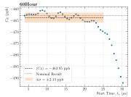
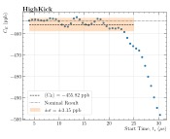
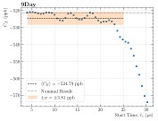
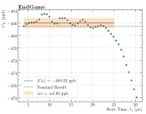
Dependence on start time

Slide 40
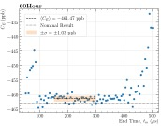
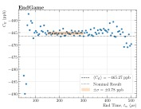
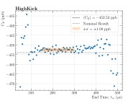
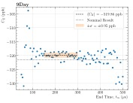
Dependence on End time

Slide 41
Run dependence

Slide 42
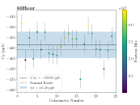
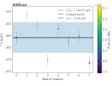
Calorimeter dependence
24 calorimeters
Bunch dependence
8 bunches

Slide 43




Dependence on positron energy
200 MeV energy bins

Slide 44
Momentum – time correlation
The kicker field is not uniform across the the length of the muon pulse.
Momentum acceptance scales inversely with kicker field.
The result is a t=0 momentum-time correlation in the stored beam
simulation
simulation
Debunching is no longer symmetric forward and backward in time.
- the fundamental prerequisite for the Fourier method

Slide 45
Fourier method reproduces true frequency distribution with no correlation
at least with Toy MC
T. Barrett

Slide 46
Initial distribution is generated with simulated correlation, and measured frequency and temporal distributions
bmad
ΔC_{e} = 67 ppb
ΔC_{e} = 40 ppb
There is no such feature in the Run 1 data
We conclude that the error due to correlation is limited to 50 ppb
More than that and we would see it.
cosy
Signature of correlation

Slide 47
Fourier method results
Correlated run to run
Correlated run to run
For detailed Run 1 analysis see
GM2-doc 21258
GM2-doc 21678

Slide 48
Efield summary
Momentum-time correlation uncertainty dominates everything else
In the works
CERN/χ² method: Fit parameterized initial distribution to S(t). Correlation can be included in parameterization. Rob C. is extending the method with special functions to reduce the number of parameters to fit
The fast rotation signal is number vs time. Trackers measure radial position and number vs time, allowing possibility of reconstructing correlation. (James M.)

Slide 49
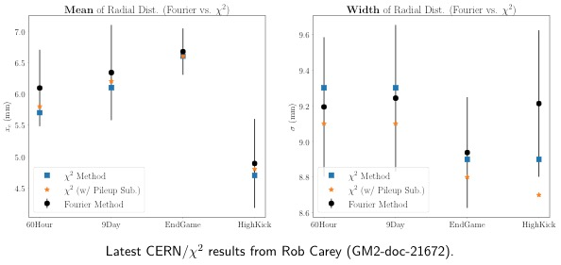

Slide 50
Thanks to everyone who participated in Efield/pitch discussions and contributed to this work.
END

Slide 51
Q1 long Top and bottom
All 4 plates

Slide 52
Running average
Index from measured tunes
~ 150 muon decays / run

Slide 53
Simulation with gm2ringsim
10⁹ muons thrown at ring
Equilibrium radius (truth) measured at tracking planes
Fast rotation signal is calo hits

Slide 54
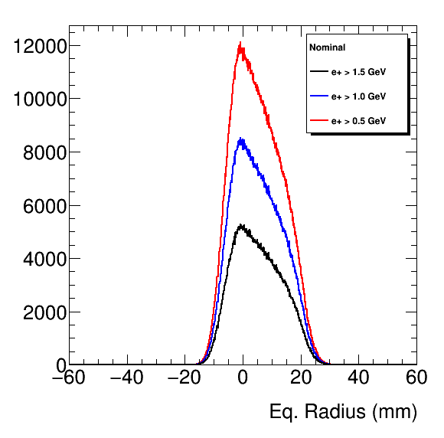
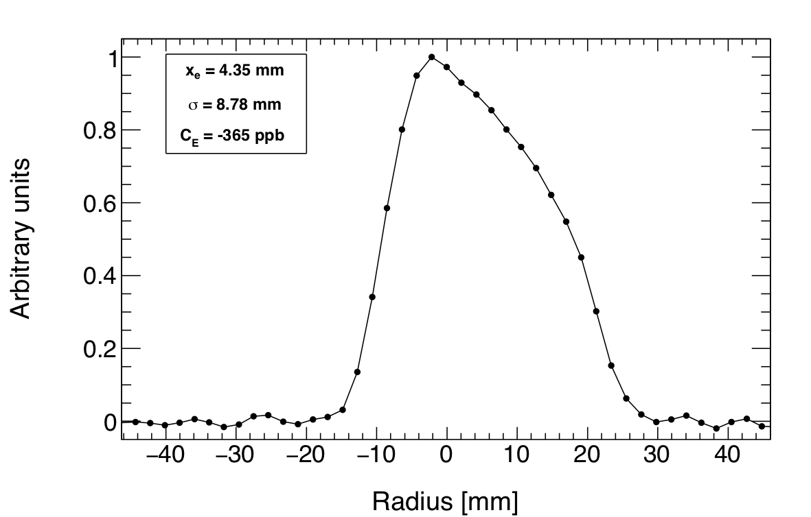
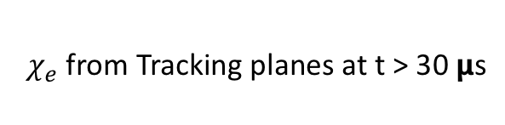

$χ_{e}$from Tracking planes at t > 30 𝝻s
Cornell FR reconstruction from decay positrons in calorimeters ( 4< t < 150 𝝻s )
$$χ_{e}=R_{magic}\frac{Δp}{p_{magic}(1−n)}$$
Means are different 5.060 ➝ 4.35. but shape comparison looks good.
Mean
5.00+/-0.00498
5.03+/-0.00591
5.06+/-0.00752
Width
8.28+/-0.00352
8.28+/-0.00418
8.28+/-0.00532
e⁺ > 1.5 GeV

Slide 55
``Statistical Error” on FR extraction
73 randcom variations over same input data
Average Mean = 4.35 +/- 0.021
Width of Mean = 0.17 +/- 0.019
Average Width = 8.84 +/- 0.030
Width of Width = 0.22 +/- 0.023
Difference between truth and FR reconstruction is significant.

Slide 56
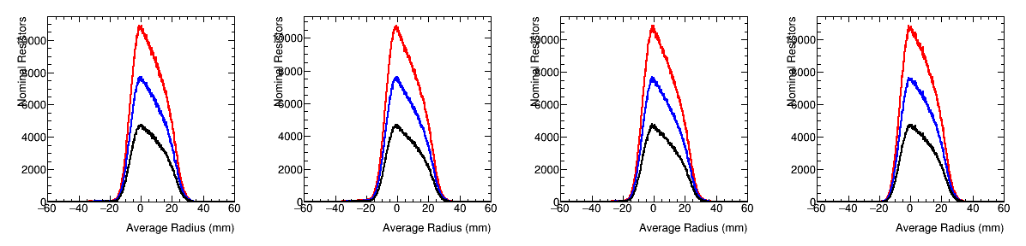
Average Radius <R> from Tracking planes for t > 30 𝝻s.
Averaged over all planes <R> ~ 5.6 mm
Plane 0 Mean
5.73 +/- 0.0057
5.76 +/- 0.0068
5.80 +/- 0.0086
Plane 1 Mean
5.25+/-0.0059
5.29+/-0.0070
5.34+/-0.0089
Plane 2 Mean
5.57 +/- 0.0058
5.59 +/- 0.0069
5.62 +/- 0.0088
Plane 3 Mean
6.039 +/- 0.0057
6.049 +/- 0.0067
6.071 +/- 0.0085

Slide 57
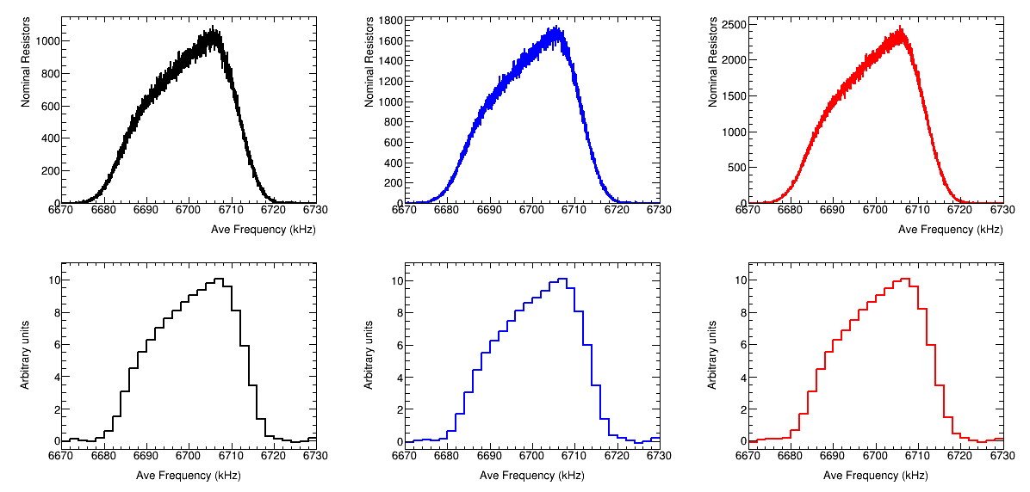
Compare Frequency Spectrum
e⁺ > 1.5 GeV
e⁺ > 1.0 GeV
e⁺ > 0.5 GeV
6699.62+/-0.0080
6699.66+/-0.0063
6699.68+/-0.0053
Tracking Plane 0 (all look the same)
Fast Rotation Extraction
6700.94+/-0.80
6700.99+/-0.80
6700.91+/-0.80

Slide 58
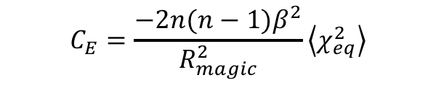
Maximal Error?
How does the deviation between the fast rotation analysis and the “truth” from the tracking planes bias the E-field correction? (n = 0.108)
FR ➔ 365 ppb
  Mean 4.35
  Width 8.78
TRUTH ➔ 358 ppb
  Mean 5.06
  Width 8.28
$$C_{E}=\frac{−2{n(n−1)β}^{2}}{R_{magic}^{2}}\left\langle χ_{eq}^{2}\right\rangle$$
Deviation is 7 ppb

Slide 60
T. Barrett

Slide 61
D. Tarazona T. Barrett

Slide 62
T. Barrett

Slide 63
Time-momentum correlation introduces systematic error in Fourier method
The correlation will depend on kicker parameters
Modeling the correlation may be problematic

Slide 64
Summary
E-field
Correlation systematic dominates uncertainty of E-field contribution
We are exploring refinements to Fourier method to mitigate effects of correlation
Redefine t₀ to peak of fast rotation signal (maximal bunching point) ?
χ² method? Parameterize initial distribution and fit to S(t).
Correlation can be included in that parameterization
Or perhaps a hybrid of Fourier and χ² method?
Pitch
Effects of misalignments are small
Remaining uncertainty dominated by relative acceptance
In progress

Slide 65
E-field contribution
Quad linearity
In an ideal cartesian geometry and quadrupole where the horizontal field is antisymmetric about the closed orbit, the E-field correction is independent of betatron amplitude
E
In a curved geometry, the integrated E-field along the trajectory depends on betatron amplitude in two ways
Sextupole (quadratic) component of the quads
  Sextupole component is symmetric about magic radius
  Shifts the ‘closed orbit’
Path length (asymmetric about magic radius)

Slide 66
#2
#3
#1
#4
#5

Slide 67
All 1280 configurations
truth
measured - truth

Slide 68
Systematic uncertainty due to quad misalignment/voltage errors for 1280 configurations
Efield
Where and
Pitch
Where

