Slide 1
Pitch Correction and Calorimeter Acceptance
James Mott
g-2 E-field/Pitch Meeting - 03/05/20

Slide 2
Pitch Correction: Status
Now have resolution/acceptance corrected tracker distributions (see Joe’s talk)
Two pieces left before cranking the handle:
  Vertical frequency fits
    Use this to get n (and work out how to weight appropriately)
  Calorimeter acceptance
    Expect to be small, but don’t know how to get systematic without actually applying it
    Also want to have a complete recipe going forwards
Today I’ll talk about the calo acceptance plan

Slide 3
Vertical Motion and Measured Position
Let’s think about muon motion and how calo acceptance fits in.
Each muon is oscillating up and down in betatron motion:
y
t
Time spent at each position
(same as decay distribution)

Slide 4
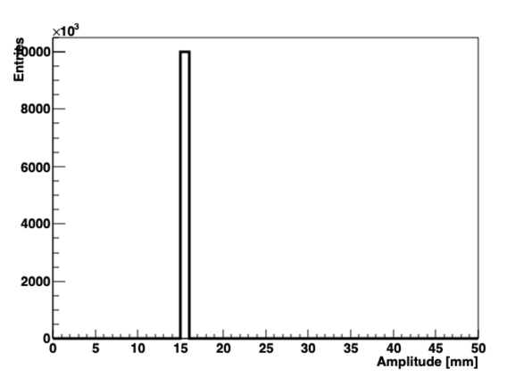
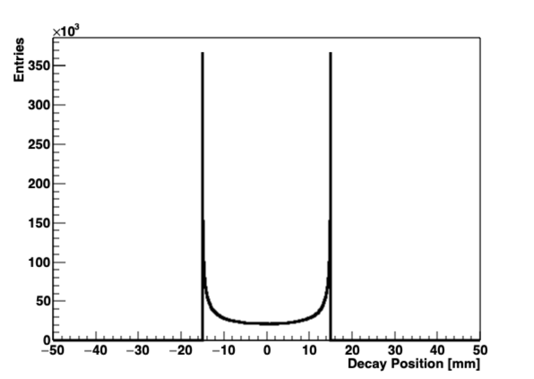
Toy MC: Single Amplitude
Move from cartoon to toy MC – just single betatron amplitude here:
Pretty nifty cartoon I’d say, almost like I knew what the toy MC would say before drawing it…

Slide 5
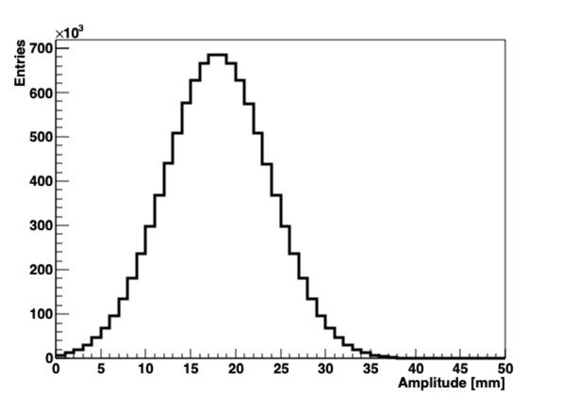
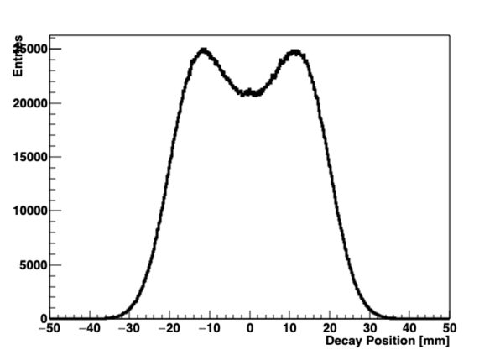
Toy MC: Distribution of Amplitudes
Can extend single case to a (made-up) distribution of amplitudes:
The left plot is the natural one to get the pitch correction
The right plot is what we would measure in the tracker (assuming we do all our acceptance/resolution corrections right)

Slide 6
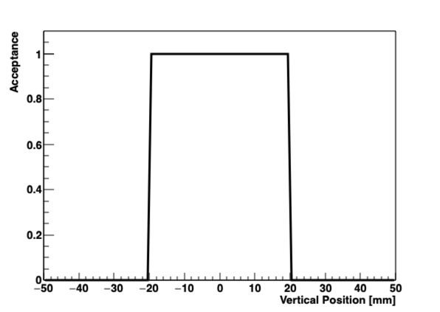
Toy MC: Simple Calo Acceptance
Now let’s take our decay positions and ask which end up in the calorimeters
We start by applying an unrealistic box function to gain understanding:

Slide 7
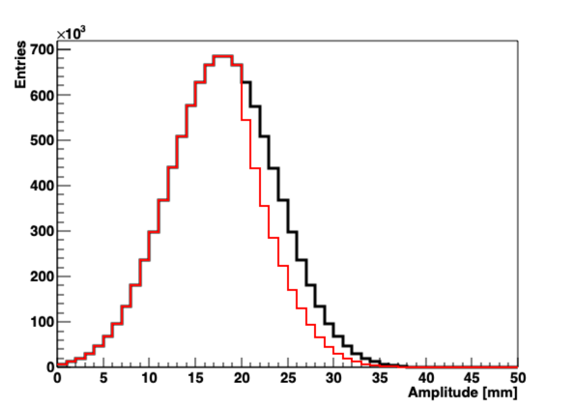
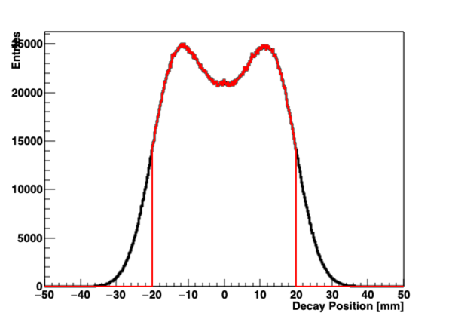
Toy MC: Simple Calo Acceptance
Decay distribution gets truncated at +/- 20 mm
Amplitude distribution starts to reduce at this point
High amplitudes (pitch corrections) are still present, but are reduced as sometimes they decay outside the acceptance
Can’t weight RHS plot by acceptance and use <y²>
Beam
Calo Measured
C_{p} = 191 ppb
C_{p} = 170 ppb
C_{p} = 191 ppb
C_{p} = 135 ppb
This is right
This is wrong

Slide 8
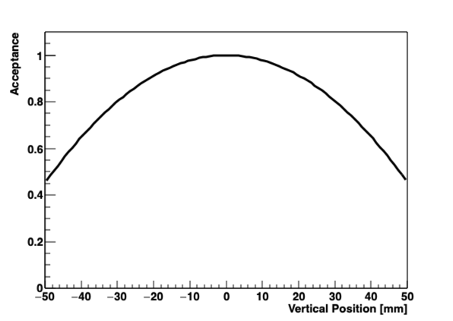
Toy MC: Realistic Calo Acceptance
Box function is non-physical – let’s do same exercise with something a little more realistic:
Uses gm2ringsim (gas gun) and E > 1700 MeV. I’ve put all the calos together here.

Slide 9
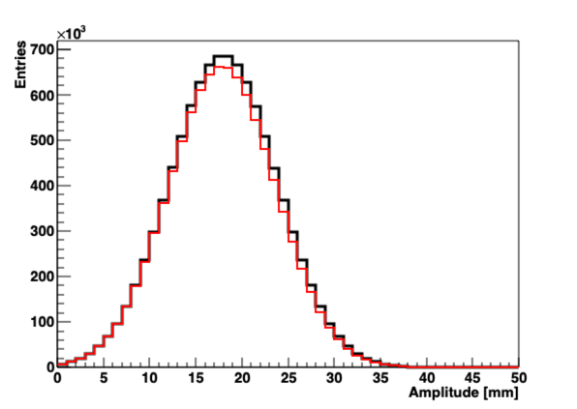
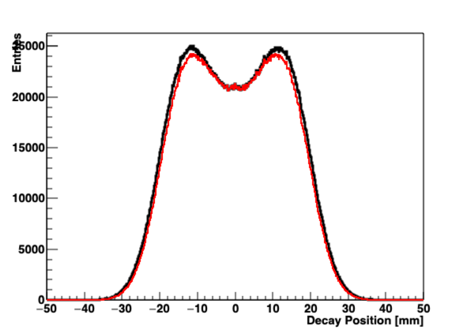
Toy MC: Realistic Calo Acceptance
Effect is the same as before, but more subtle.
In this made up toy MC case, we’re actually only off by 5 ppb
Now we need to do something similar with real data…
Beam
Calo Measured
C_{p} = 191 ppb
C_{p} = 188 ppb
C_{p} = 191 ppb
C_{p} = 183 ppb
This is right
This is wrong

Slide 10
Calo Acceptance & Weighting
If we have a betatron amplitude, we can calculate its appropriate weighting based on the calo acceptance maps
We just need to multiply the two distributions together to get how often the muon decays as is seen by calos:
There’s some fiddling to be done to deal with changing β and non-constant vertical acceptance but it’s all do-able
⊗

Slide 11
Decay Position → Amplitude
We want the betatron amplitudes but we measure the instantaneous decay position
We can use our CERN-III machinery to do this conversion…
Moral: Never throw anything away

Slide 12
Decay Position → Amplitude: Single Amplitude
Let’s go back to simple example with just one amplitude:
We can calculate the number of entries in the decay position histogram that we expect from this amplitude…

Slide 13
Calculating One Amplitude’s Contribution
Mean y is set to be same as data
In any given measurement y-bin j we have this contribution from amplitude bin i with entries f_{i}:
I actually also go within an amplitude bin i and average all the contributions – can do 2D integral over y and A to speed things up

Slide 14
Expanding to many amplitudes:
System is linear, so we just sum up the contributions:

Slide 15
Minimising χ²:
We want to find the amplitude coefficients f_{i} that match the measured data N_{j}
We should be careful with χ² (as we might have low entries in outer bins) but it’s what we’ve got the machinery for
Minimise χ² for each coefficient f_{n}:

Slide 16
Minimising χ²:
We have n equations and n unknown f_{i} values:
“Simple” matrix equation & solution: already have this coded up for CERN-III

Slide 17
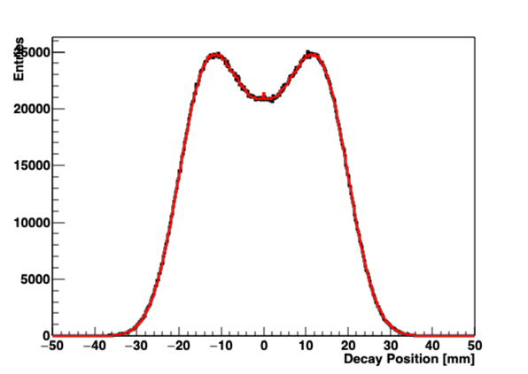
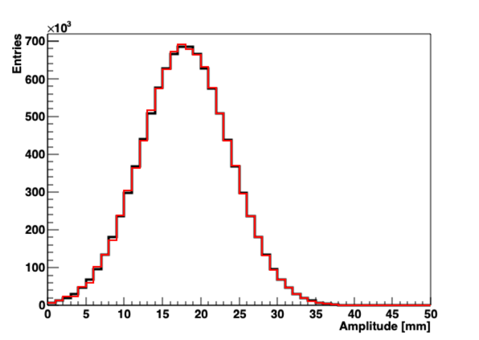
Toy MC: Amplitude Extraction in Action
It works! Recover input amplitude distribution from position measurements:
χ² value is fine here, but breaks down with higher stats.
Recovers again when you increase number of amplitude bins
Input
Fit
C_{p} = 191 ppb
C_{p} = 191 ppb
C_{p} = 191 ppb
C_{p} = 191 ppb
χ² / ndf = 0.99

Slide 18
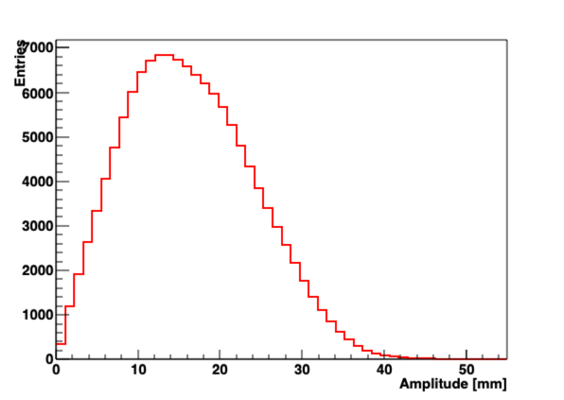
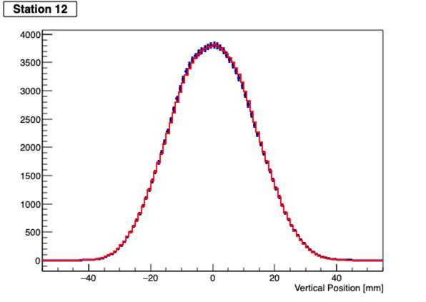
Data: Amplitude Extraction in Action
Run 15922: Station 12
Data
Fit
Looks reasonable, but we need to fix errors on resolution corrected data before we can really check χ² and agreement
Is this amplitude distribution useful for tuning BD models?
C_{p} = 176 ppb
C_{p} = 177 ppb
C_{p} = 176 ppb

Slide 19
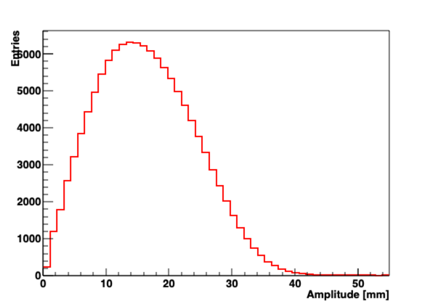
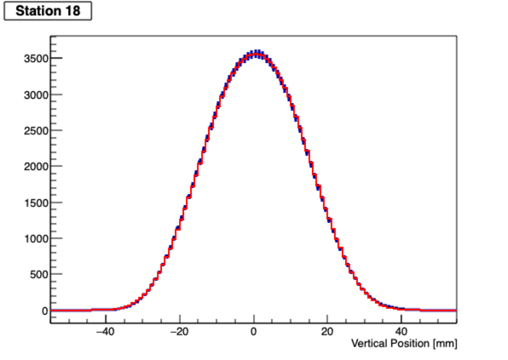
Data: Amplitude Extraction in Action
Run 15922: Station 18
Data
Fit
Looks reasonable, but we need to fix errors on resolution corrected data before we can really check χ² and agreement
Is this amplitude distribution useful for tuning BD models?
C_{p} = 177 ppb
C_{p} = 178 ppb
C_{p} = 177 ppb

Slide 20
Conclusions/Next Steps
We’ve got a method to convert between y-distribution and underlying amplitudes
This is a much more natural space to apply the calorimeter acceptance corrections
Next steps:
  Use station-by-station acceptance corrections
  Use correct errors on data to check model works well enough
  Calculate & apply calorimeter acceptance to amplitudes
  Vertical frequency fits
Semi-related next step: can we use a similar technique to this to do the B-field convolution in xy?

