Slide 1
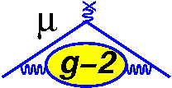
Muon Beam Dynamics and Spin Dynamics in the g-2 Storage Ring
D. L. Rubin, Cornell University
A.Chapelain, Cornell University, F. Gray, Regis University
S.Charity, J. Price, University of Liverpool
Joe Mott, Boston University
J.D.Crnkovic, W. Morse, V. Tishchenko, Brookhaven National Laboratory
W. Wu, University of Mississippi

Slide 2
Muon g-2 experiment
Goal
  measure the anomalous magnetic moment of the muon (g-2) with 0.14 ppm uncertainty (BNL 0.54 ppm)
Method
  Circulate polarized muons at the ‘magic’ momentu, in uniform magnetic field and measure precession frequency
Polarized muons
  select of highest energy muons in
Measure muon polarization
  Correlation with energy of decay positrons
Notes:
Goal of the experiment
Method to store polarized muons and measure polarizaiton when they decay
How to get polarized muons. How to measure polarization.
Equation for omega a for muons on axis and with particular momentum
Movie
Storage ring picture. With the specifications.
Electrostatic quads – twiss – tunes
Injection – apertures – mismatch
Detectors – Measurements
Tunes
Injection dependencies – angle, kick, another drawing
What we learn from distribution that is stored
On and off energy
Measurements
Equation
What we need to know to understand systematics

Slide 3
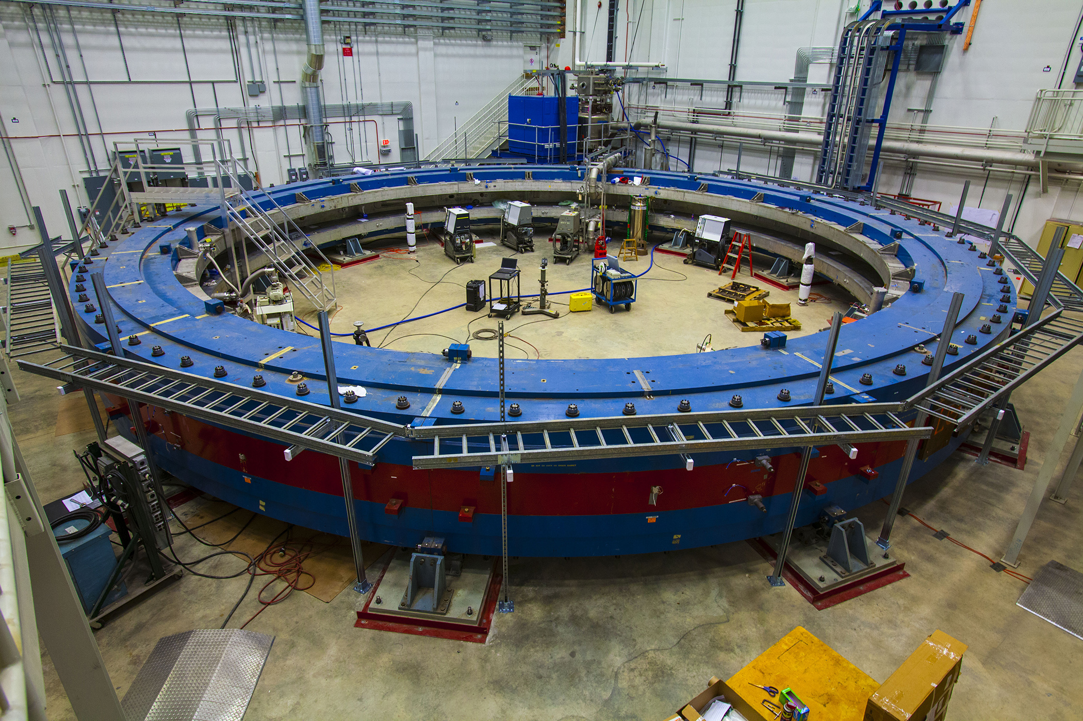
Status
Commissioning run summer 2017
Production run is just beginning
Statistics in excess of BNL by summer 2018
Upgrades of several systems planned for summer 2018

Slide 4
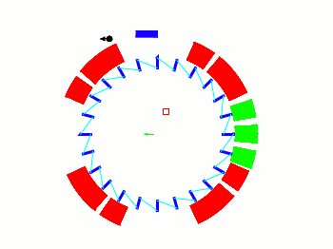

Muon storage ring
inflector
ES quad
(ideal field and trajectory)
M5 line
kickers
Requirement of uniform B-field
=> electrostatic focusing
24 calorimeters
Circumference = 44.69 m

Slide 5
Muon storage ring
Circumference = 44.69 m
Revolution period = 149.1 ns
B_{y} = 1.45 T
P_{μ} = 3.09 GeV/c
γ = 29.3 =
Aperture = 9 cm
τ_{μ} =64.4 μs (at 3.09 GeV/c) = 432 turns

Slide 6
Electrostatic quadrupoles
711.2 cm
10.8 mrad
9 cm
Quads span 156º of arc

Slide 7
Weak focusing lattice

Slide 8
Muon decay
=> Highest energy positron
e⁺
Correlation of positron energy with muon spin is measure of muon polarization
μ⁺

Slide 9
Calorimeters
24 calorimeters measure positron energy and time
calorimeters
e⁺
μ⁺

Slide 10
Calorimeters
Histogram of high energy positrons
e⁺
μ⁺

Slide 11
Injection
1.7m
=77mm
B_{I}= -1.45 T
B_{R}=1.45 T
1.8cm
ΔB/B < 70 ppb
5.8 cm
711.2 cm
Inflector
aperture
Injection mismatch
9 cm

Slide 12
Injection
Muons come to the end of the M5 line and then propagate through:
Hole in magnet yoke
Dipole fringe field
Inflector
And exit the inflector 77 mm from the center of the dipole aperture
The magnetic field is near zero at the inner surface of the yoke, and rises to 1.45T between the magnet poles, over a distance of ~39cm
39cm

Slide 13
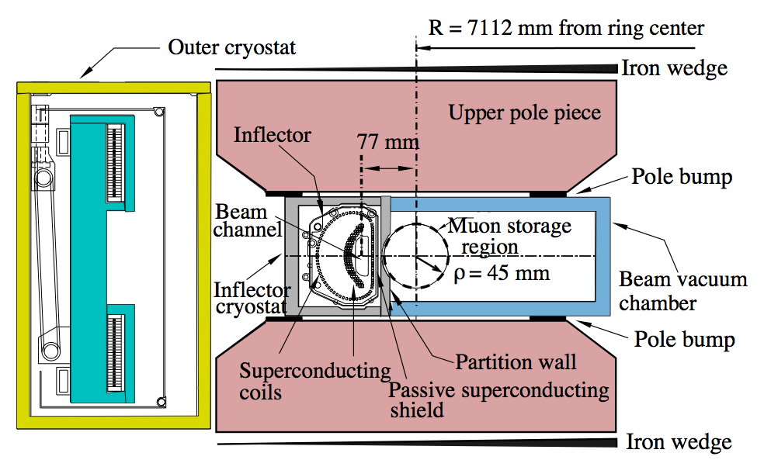
Inflector
1.8 cm
5.8 cm
Inflector
aperture
Apertures
Inflector half-width = 9mm
Inflector half-height = 28mm
Storage volume radius = 45mm

Slide 14
Injection phase space
Injected beam
ε = 40 mm-mrad (95%)
Δp/p = 2%
Hole in backleg iron
Beam is focused to a waist to clear inflector aperture
(Muons are scattered in coil overlapping inflector aperture)
Dispersion is zero in inflector
ring
inflector
=> Dispersion and phase space mismatch
Ring
β_{x} = 7.8 m
η = 8.2 m

Slide 15
Injection channel
7.112 m

Slide 16
Injection Dependencies
Injected particles oscillate about the closed orbit with amplitude that depends on; momentum, injection angle, offset, and kick angle
Amplitude and envelope of betatron oscillation of stored beam depends on
injection angle θ and
Kicker angle
Momentum
Trajectory of magic momentum muon
Inflector rotated clockwise
Δp/p
inflector
θ
offset
kicker
Δφ = π/2
Injection point to kicker

Slide 17
Muon capture
Envelope of betatron motion of stored muon
(10.8 mrad kick angle puts on momentum muon on axis)

Slide 18
Muon capture
Envelope of betatron motion of stored muon
(10.8 mrad kick angle puts on momentum muon on axis)

Slide 19
Muon capture
Envelope of betatron motion of stored muon

Slide 20
Muon capture
Envelope of betatron motion of stored muon
(8 mrad kick = 75% nominal – under kicking)

Slide 21
Muon capture
In the event of under kicking
Acceptance is skewed to higher momenta

Slide 22
Measurement
Systematics
In general
Finite momentum distribution
Transverse motion
Non zero E-field

Slide 23
Pitch correction
Pitch correction:
Contribution depends on vertical phase space distribution
Correction requires measurement of
vertical phase space

Slide 24
E-field correction
E-field correction:
Choose momentum.
At
Correcting for contribution from non-magic momentum muons requires
Measurement of momentum distribution
Measurement of radial distribution

Slide 25
Acceptance correction
The acceptance of the calorimeters depends on the radial offset of the decay muon
Radial offset varies with modulation of beam width
And with oscillation of the centroid
Correction requires measurement of
evolution of radial distribution

Slide 26
Detectors
Fiber Harps
Traceback trackers
Calorimeters

Slide 27
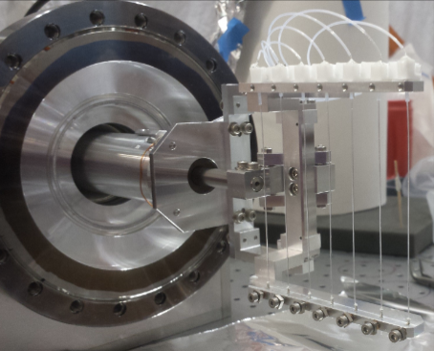
Fiber Harps
Horizontal and vertical fiber harps at 180 and 270
270º
μ⁺
180º

Slide 28
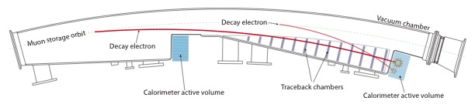
Traceback trackers
Measure trajectory of decay positron
Traceback to position of parent muon
μ⁺
e⁺

Slide 29
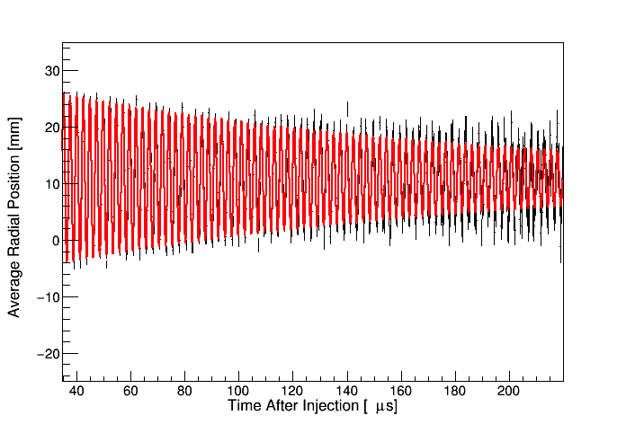
Beam centroid
Measurement of evolution of centroid
180 deg harp
270 deg harp
Fiber harp
tracker
Decohere

Slide 30
Fiber harp
Radial width / 150 ns
- Phase space and dispersion mismatch at injection
- Width modulated at Q_{x} and 2Q_{x} => dispersive and betatron components
-
180 deg harp
270 deg harp
horizontal

Slide 31
Fiber Harp
Vertical height / 150 ns
Modulation at 2Q_{y} => phase space mismatch at injection
Informs pitch correction
180 deg harp
270 deg harp

Slide 32
Tune
FFT of fiber harp centroid
Antoine’s plots

Slide 33
Tune scan
Tune along quad voltage contour

Slide 34
Momentum distribution
Positron intensity in calorimeters
Remove decay and precession

Slide 35
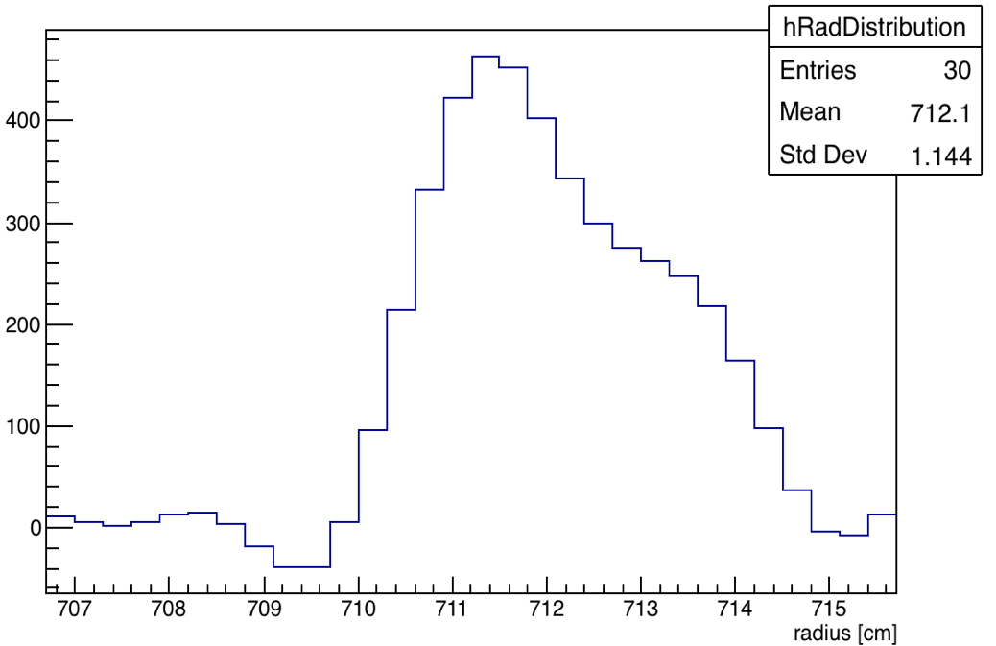
Momentum Distribution
Fit momentum distribution to debunching signal
Magic momentum
Fourier analysis of fast rotation signal
Frequency distribution
Distribution of revolution frequencies is the distribution of momenta. Fourier transform of the fast rotation signal => frequency distribution

Slide 36
Radial distribution
Average radial distribution measured with traceback tracker
(Radial distribution convoluted with detector acceptance)

Slide 37
Momentum distribution
Momentum distribution is ‘high’
Injection kicker is under-kicking and/or tails of the muon pulse are in the rising and falling tails of the kick
Muon pulse
Kicker pulse
149 ns

Slide 38
Nonlinearity
Quad field error

Slide 39
Resonances
Tune scan
Stored muons
Quad voltage

Slide 40
Summary
A quantitative understanding of the evolution of the muon distribution over the course of the fill is essential to limiting the systematic uncertainty in the measurement of the anomalous magnetic moment to the 70 ppb (systematic) target.
The Muon g-2 experiment is equipped with detectors that can measure phase space and momentum distribution in some detail.
Beam dynamics simulations informed by the measurements complete the description.
The preliminary data presented was collected during the commissioning phase of the experiment.
Based on that data it is clear that the fiber harp and tracker systems are an effective window on the behavior of the circulating distribution.

Slide 41
Thanks
A.Chapelain, Cornell University, F. Gray, Regis University
S.Charity, J. Price, University of Liverpool
Joe Mott, Boston University
J.D.Crnkovic, W. Morse, V. Tishchenko, Brookhaven National Laboratory
W. Wu, University of Mississippi
K. S. Khaw, A.T. Feinberg, University of Washington
All of the Muon g-2 Collaboration (E989)
Commissioning the Superconducting Magnetic Inflector System for the Muon g-2 Experiment – N.S.Froemming et al. WEPAF014
Commissioning the Electrostatic Quadrupole System for Muon g-2 - J.D. Crnkovic et al. WEPAF015
Application of Quad-Scan Measurement Techniques to Muon Beams in the Muon g-2 Experiment – J. Bradley et al. WEPAF016
Lost Muon Function for the Muon g-2 Experiment – S.Ganguly & J.D.Crnkovic THPAK139
New Fast Kicker Results from the Muon G-2 Experiment – A.P.Schreckenberger et al. THPML093
Using Time Evolution of the Bunch Structure to Extract the Muon Momentum Distribution in the Muon g-2 Experiment – W. Wu, B. Quinn, J.D.Crnkovic
Initial Studies into Longitudinal Inization Cooling for the Muon g-2 Experiment - J. Bradley et al.
Correction of the Effect of the Coherent Betatron Oscillation with RF Electric Field for Muon g-2 experiment – O. Kim et al. THPAF010

Slide 42
backup

Slide 44
Muon storage ring
B=1.45 T
ΔB/B < 70 ppb
711.2 cm
9 cm

Slide 45
Muon storage ring
711.2 cm
9 cm

