Slide 1
Efield and Pitch Corrections
D. Rubin - for the Efield/Pitch working group

Slide 2
Electric field
Measure Δp/p and E-field
As long as the quadrupole field is linear in displacement
Measurement of radial closed orbit, => E-field correction

Slide 3
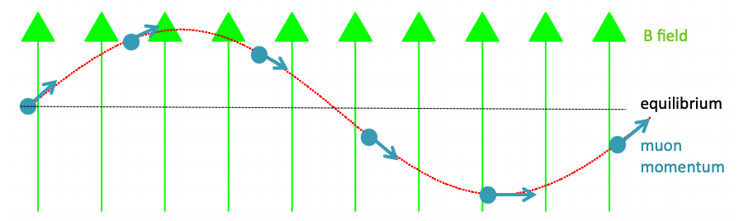
Why do we need a pitch correction?
Muons are going up-and-down in the ring (focused by quads):
Stolen from James Mott
Precession in a single revolution is independent of vertical oscillation
But the revolution period is not.

Slide 4
y₀
Pitch and ω_{a}
B_{y}
We measure precession about the axis perpendicular to the direction of motion.
The component of the magnetic field along that perpendicular axis is B cos ψ.
The spin tune
Path length
=> spin tune is independent of pitch
But

Slide 5
In the limit of continuous and perfectly aligned quads, with linear dependence of E-field on displacement, the contribution to ω_{a} from
Electric field
Pitching angle
Single muon
For the distribution
Single muon
For the distribution

Slide 6
In the limit of continuous and perfectly aligned quads, with linear dependence of E-field on displacement, the contribution to ω_{a} from
Electric field
Pitching angle
Single muon
For the distribution
Single muon
For the distribution
Bottom line
How well can we measure , , and ?
What is the effect of nonlinearity, voltage errors and misalignment?

Slide 7
Quad Nonlinearity
E_{r} is not simply linear in x
Index n and dispersion η depend on x
Quad curvature => quadratic dependence (sextupole-like)
Sextupole component => amplitude dependent shift of the closed orbit
Quad plate
E_{x}
E_{y} = 0
x
Quad index n is proportional to

Slide 8
Systematically explore dependence of E-field and Pitch correction on
field and alignment errors and nonlinearity with simulation
Quad plates
ΔV_{p} = ± 5% V₀
±1mm
There are 2⁴ combinations of displacement errors. Two for each plate and 4 plates
There are 2⁴ combinations of voltage errors. Two for each plate and 4 plates
=> 256 combinations of displacement and voltage errors
For each quad
Q1 S
Q1 L
Q2 S
Q2 L
Q3 S
Q3 L
Q4 S
Q4 L

Slide 9
#1 d1s2s3s4V1s2s3s4 - displacement and voltage errors for all inner/bottom/top/bottom plates the same
Q1 S
Q1 L
Q2 S
Q2 L
Q3 S
Q3 L
Q4 S
Q4 L
#2 d1s2a3a4V1s2a3a4 - displacement and voltage errors on Q2 all equal to Q1, on Q3 and Q4 opposite to Q1
Q1 S
Q1 L
Q2 S
Q2 L
Q3 S
Q3 L
Q4 S
Q4 L
#3 d1a2s3a4V1a2s3a4 - displacement and voltage errors on Q3 all equal to Q1, on Q2 and Q4 opposite to Q1
Q1 S
Q1 L
Q2 S
Q2 L
Q3 S
Q3 L
Q4 S
Q4 L
#4 d1a2s3a4V1s2a3a4 v- disp errors Q3 = Q1, Q2 & Q4 opposite Q1. volt errors Q2=Q1, Q3 & Q4 opposite Q1
Q1 S
Q1 L
Q2 S
Q2 L
Q3 S
Q3 L
Q4 S
Q4 L
#5 d1a2a3a4V1a2a3a4 - displacement and voltage errors on Q2, Q3 and Q4 opposite Q1
Q1 S
Q1 L
Q2 S
Q2 L
Q3 S
Q3 L
Q4 S
Q4 L

Slide 10
Pitch correction - truth
#1
#3
#2
#5
#4

Slide 11
Pitch correction –measured-truth
#1
#2
#3
#4
#5
(1280 configurations)

Slide 12
Efield correction - truth
#1
#2
#3
#4
#5

Slide 13
#2
#3
#1
#4
#5

Slide 14
All 1280 configurations
truth
measured - truth

Slide 15
The betatron frequencies of the horizontal and vertical motion of the centroids => Qx, Qy

Slide 16
Systematic uncertainty due to quad misalignment/voltage errors for 1280 configurations
Efield
Where and
Pitch
Where

Slide 17
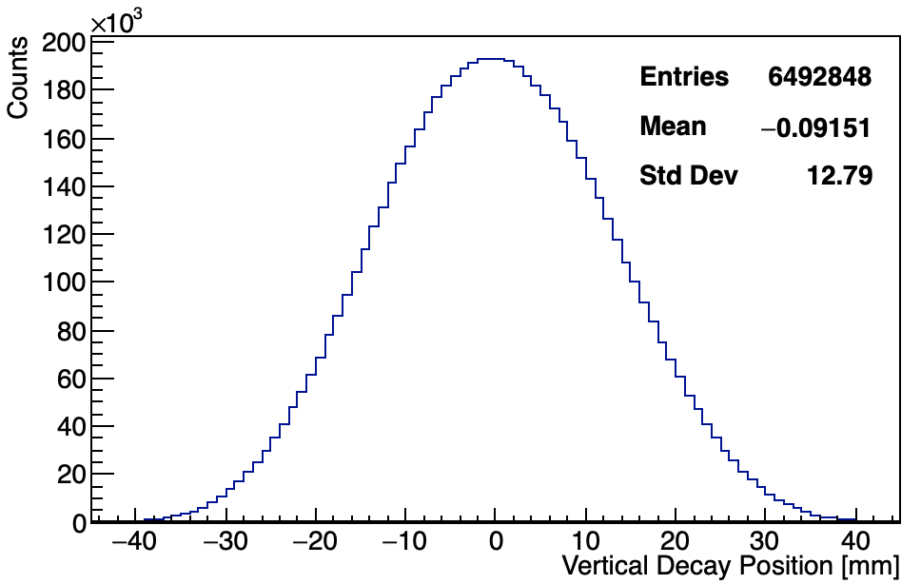
Pitch Measurement
Measure vertical position of decay muon by reconstructing trajectory of positron in straw tracker
  All muons => <y²>
  <y(t)> => vertical tune and
60h
(Uncorrected)
For us (60h):
σ_{y} ∼ 12.5 mm, y² ~ 150 mm²
C_{p} ∼ 160 ppb
σ_{y} = 12.8 mm
J. Mott

Slide 18
Tracker systematics
Alignment
  External Alignment
  Internal Alignment
  Detector curvature
  Straw angle alignment
Tracking algorithm
  Time to distance
  t₀ offset
  Material Density
  Track finding
  Measurement resolution
Cross-talk
Lost muons
Tracking resolution
Beam spot resolution
Tracker Acceptance
Calo acceptance
A small fraction of the muons that contribute to measurement of ω_{a} generate tracker hits
J. Mott

Slide 19
Uncertainties Summary:
Systematic | C_{p} systematic [ppb]
Tracking | 8.6
Vertex Resolution | 3
Total | 9.1
Uncertainty excluding acceptance is ~10 ppb
Acceptance correction itself will be less than 20 ppb with small error
Simulation/Model uncertainty is also 10 ppb
Total correction expected to be ~160 ± 15 ppb.
Misalignment/voltage error ~ 2 ppb
J. Mott

Slide 20
Probability of tracker reconstruction
simulation
=> Acceptance correction < 20 ppb

Slide 21
Efield correction measurement
Extract momentum distribution (or equivalently equilibrium radial distribution) from fast rotation signal
Two methods
Fourier method
CERN III (χ²) method
The fast rotation signal is comprised of all calo hits above threshold
No acceptance correction required

Slide 22
At , beam is maximally bunched. As , muons distributed uniformly around ring
S(t) is symmetric about
Fourier method
J. Fagin

Slide 23
First 4 μs contaminated by positrons -
A. Chapelain

Slide 24
Toy Monte Carlo
T. Barrett

Slide 25
A. Chapelain

Slide 26
The Cornell Fast Rotation Fourier analysis has been done on 3 data set:
60-hour link to the analysis note: https://gm2-docdb.fnal.gov/cgi-bin/private/ShowDocument?docid=19150
9-day link to the analysis note: https://gm2-docdb.fnal.gov/cgi-bin/private/ShowDocument?docid=19252
End-game link to the analysis note: https://gm2-docdb.fnal.gov/cgi-bin/private/ShowDocument?docid=19258
The above will be amended with analysis by run number
Analysis of High Kick in progress

Slide 27
How do we convince ourselves that the Fourier method is giving us the right answer?
So far we only know that it works for Toy MC data

Slide 28
Simulation with gm2ringsim
10⁹ muons thrown at ring
Equilibrium radius (truth) measured at tracking planes
Fast rotation signal is calo hits

Slide 29
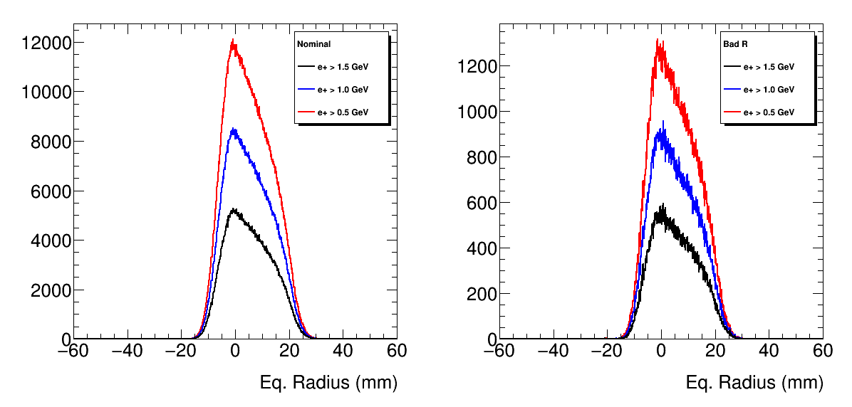
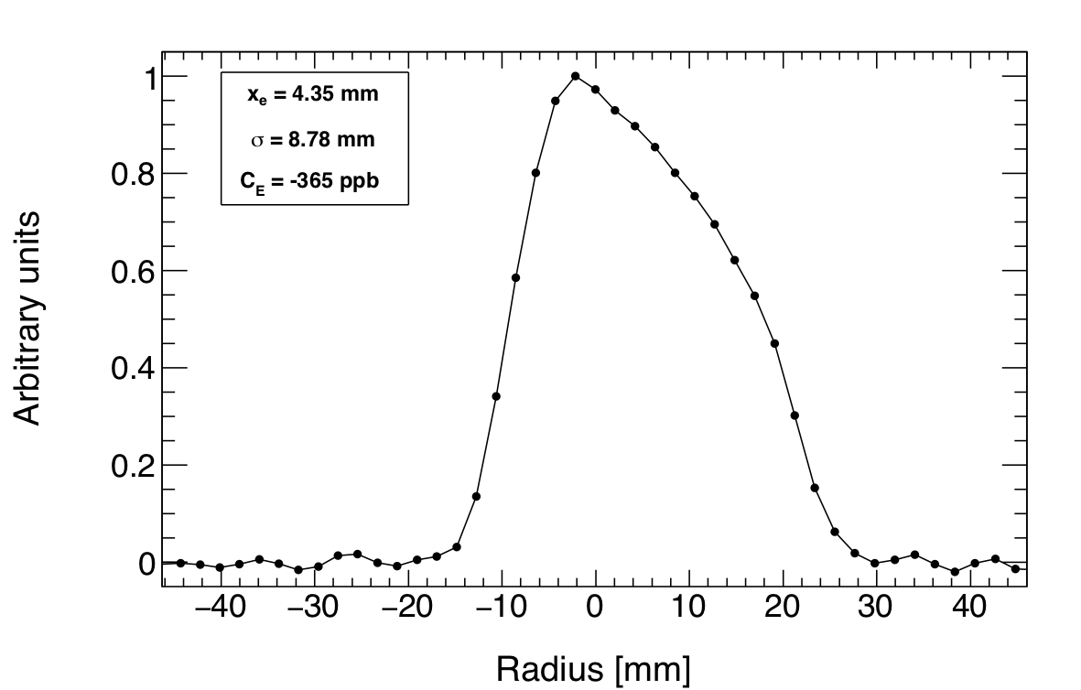
From tracking planes at t>30 μs
Cornell FR reconstruction from decay positrons in calorimeters ( 4< t < 150 𝝻s )
Means are different 5.060 ➝ 4.35. but shape comparison looks good.
Mean
5.00+/-0.00498
5.03+/-0.00591
5.06+/-0.00752
Width
8.28+/-0.00352
8.28+/-0.00418
8.28+/-0.00532
e⁺ > 1.5 GeV
R. Fatemi

Slide 30
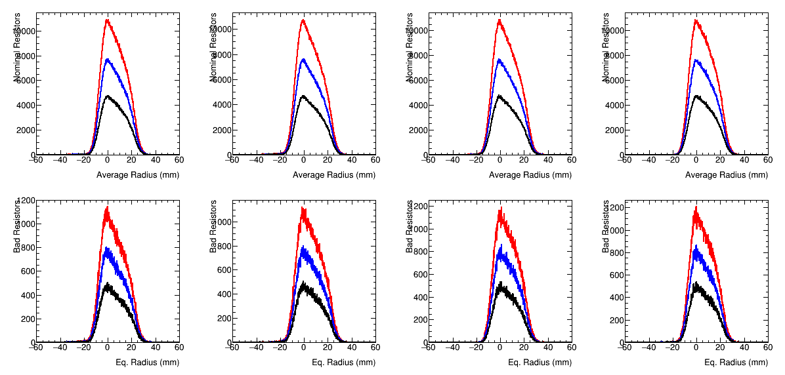
Average Radius <R> from Tracking planes for t > 30 𝝻s.
Averaged over all planes <R> ~ 5.6 mm
Plane 0 Mean
5.73 +/- 0.0057
5.76 +/- 0.0068
5.80 +/- 0.0086
Plane 1 Mean
5.25+/-0.0059
5.29+/-0.0070
5.34+/-0.0089
Plane 2 Mean
5.57 +/- 0.0058
5.59 +/- 0.0069
5.62 +/- 0.0088
Plane 3 Mean
6.039 +/- 0.0057
6.049 +/- 0.0067
6.071 +/- 0.0085
R. Fatemi

Slide 31
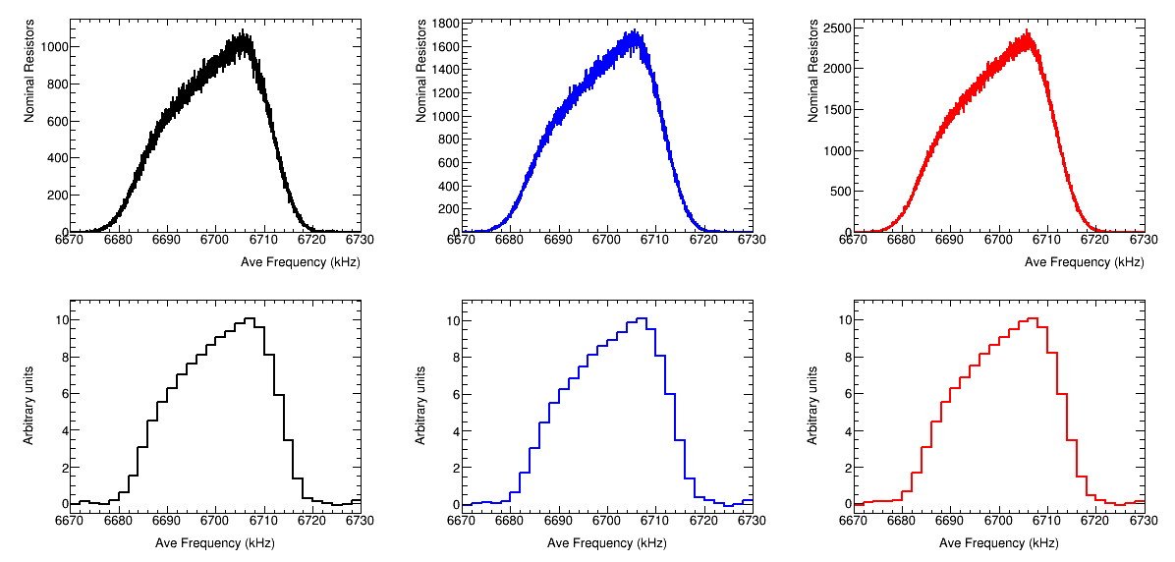
Compare Frequency Spectrum
e⁺ > 1.5 GeV
e⁺ > 1.0 GeV
e⁺ > 0.5 GeV
6699.62+/-0.0080
6699.66+/-0.0063
6699.68+/-0.0053
Tracking Plane 0 (all look the same)
Fast Rotation Extraction
6700.94+/-0.80
6700.99+/-0.80
6700.91+/-0.80
R. Fatemi

Slide 32
``Statistical Error” on FR extraction
73 random variations over same input data
Average Mean = 4.35 +/- 0.021
Width of Mean = 0.17 +/- 0.019
Average Width = 8.84 +/- 0.030
Width of Width = 0.22 +/- 0.023
Difference between truth and FR reconstruction is significant.
R. Fatemi

Slide 33
Maximal Error?
How does the deviation between the fast rotation analysis and the “truth” from the tracking planes bias the E-field correction? (n = 0.108)
FR ➔ 365 ppb
  Mean 4.35
  Width 8.78
TRUTH ➔ 358 ppb
  Mean 5.06
  Width 8.28
Deviation is 7 ppb
Fortuitous?
R. Fatemi

Slide 34
At , beam is maximally bunched. As , muons distributed uniformly around ring
S(t) is symmetric about
Fourier method assumes symmetry about t₀
Time-momentum correlation in injected distribution breaks symmetry

Slide 35
Suppose for example, that the average momentum at the head of the bunch is high – and the average momentum at the tail is low.
Then as the tail catches up with the head the distribution becomes more bunches
Extension to negative times will not be symmetric about 0
Maximal bunching
J.Fagin

Slide 36
T. Barrett

Slide 37
T. Barrett

Slide 38
Evidently the Fourier method is not robust to time-momentum correlation in the distribution
Correlation is introduced by the kicker

Slide 39
Temporal distribution of injected pulse
Kicker pulse
Average Δp/p vs time
D. Tarazona

Slide 40
T. Barrett

Slide 41
D. Tarazona T. Barrett

Slide 42
T. Barrett

Slide 43
Time-momentum correlation introduces systematic error in Fourier method
The correlation will depend on kicker parameters
Modeling the correlation may be problematic

Slide 44
60-hour summary
Fourier Fast rotation analysis
Alignment/voltage systematic
Correlation

Slide 45
Summary
E-field
Correlation systematic dominates uncertainty of E-field contribution
We are exploring refinements to Fourier method to mitigate effects of correlation
Redefine t₀ to peak of fast rotation signal (maximal bunching point) ?
χ² method? Parameterize initial distribution and fit to S(t).
Correlation can be included in that parameterization
Or perhaps a hybrid of Fourier and χ² method?
Pitch
Effects of misalignments are small
Remaining uncertainty dominated by relative acceptance
In progress

Slide 46
Average over all φ for a given amplitude a
Assumes linearity
We know that the effective quad index decreases with amplitude y

Slide 48
Many thanks to the
T. Barrett, R. Carey, A. Chapelain, J. Crnkovic, P. Debevec,J. Fagin, R. Fatemi, M. Kargiantoulakis, A. Lorente, J. Mott, J. Price, D. Tarazona, T. Walton
Efield/pitch working group

