Slide 1
Pitch Correction: Tracker Measurements
James Mott, Boston University
g-2 Collaboration Meeting
30th May 2019

Slide 2
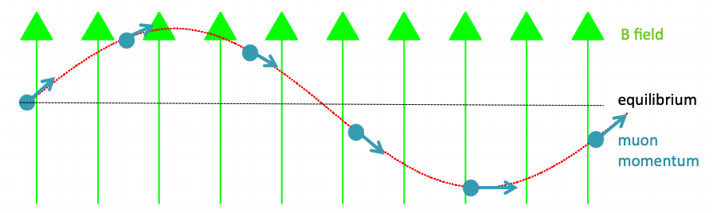
Why do we need a pitch correction?
Muons are going up-and-down in the ring (focused by quads):

Slide 3
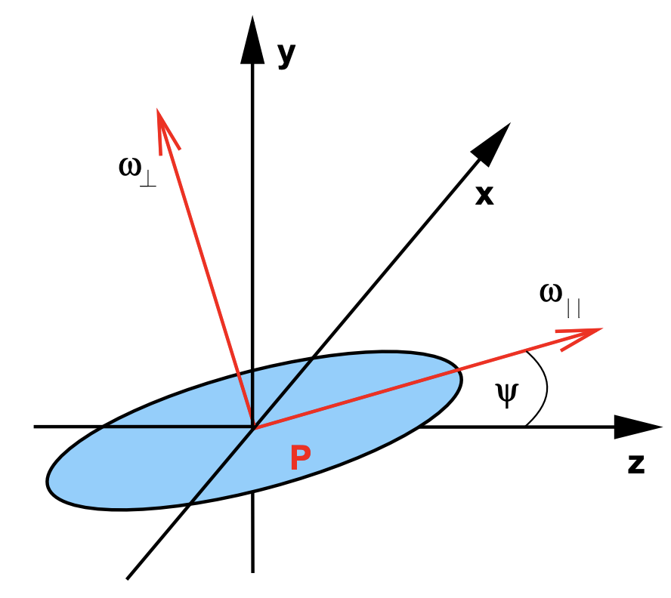
Why do we need a pitch correction?
Muons are going up-and-down in the ring (focused by quads):
Field felt by the muons is reduced:
Muon going up at this time, but angle oscillates
B
This is always positive for us

Slide 4
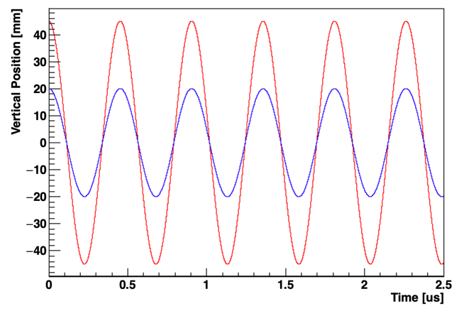
Angles and Positions:
We really care about the vertical (pitch) angle of the µ⁺
But we measure e⁺ so angle information is washed out a bit
Instead, we measure position of decay and rely on the relation between amplitude & angle of oscillation:
Averaging over all muons, we get the average correction, C_{P}:
We’ll actually use a beam dynamics model instead of this formula but it’s close
Larger amplitude ⟷ Larger angle
Smaller amplitude ⟷ Smaller angle

Slide 5
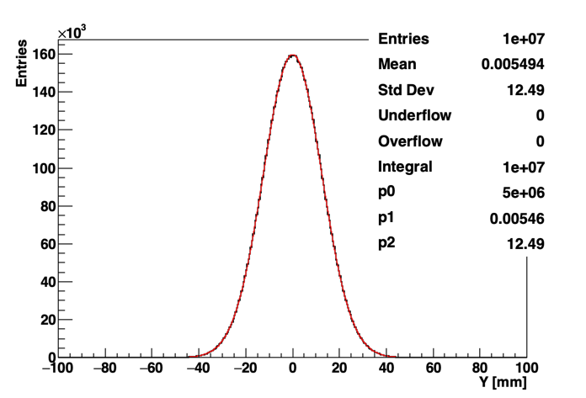
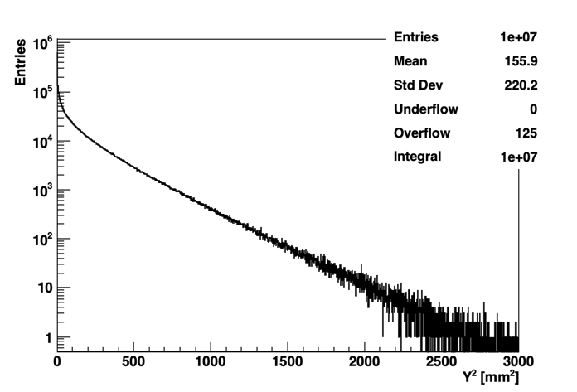
〈y²〉 is σ²
Gaussian: E[(y - µ)²] = σ² & if µ = 0, then E[y²] = 〈y²〉 = σ²
ToyMC
y-distribution
ToyMC
y²-distribution
12.49² = 156
So we’re actually measuring the width of the distribution
If whole y distribution is offset, then we want 〈(y - µ)²〉 instead of y² and it’s still the width

Slide 6
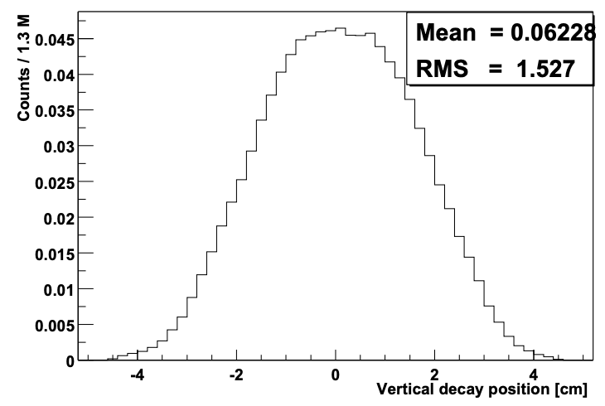
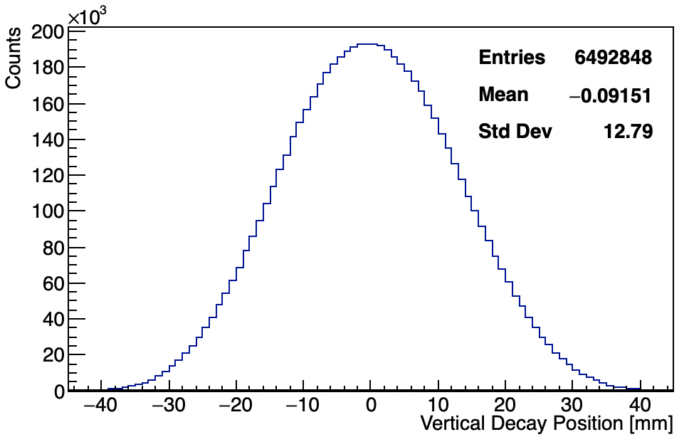
Pitch Correction: Orientation
Acceptance & Resolution Corrected
60h
(Uncorrected)
E821 2000
σ_{y} = 15.3 mm
σ_{y} = 12.8 mm
Uncorrected
In BNL 2001:
C_{p} (low n) = 270 +/- 36 ppb
C_{p} (high n) = 320 +/- 36 ppb
For us (60h):
σ_{y} ∼ 12.5 mm, y² ~ 150 mm²
C_{p} ∼ 160 ppb
C_{P} [ppb] ∼ 1.06 〈y²〉 [mm²] for n = 0.108

Slide 7
Pitch Correction: Perspective
TDR target for E-field & pitch together is 30 ppb (!)
A rough estimate (and I stress these are uneducated guesses) of where are for stats & systematics in run 1:
For Run 1, we don’t have to worry too much for the pitch correction so bear this in mind for rest of talk
Going forward, we’ll obviously have to do better
 | Uncertainty (ppb)
ω_{a} (stat) | 350
ω_{a} (syst) | 80
Field | 100
E-field | 60
Pitch | 0 | 10 | 30 | 50 | 150
Total Uncertainty | 377 | 378 | 379 | 381 | 406
Uncorrected

Slide 8
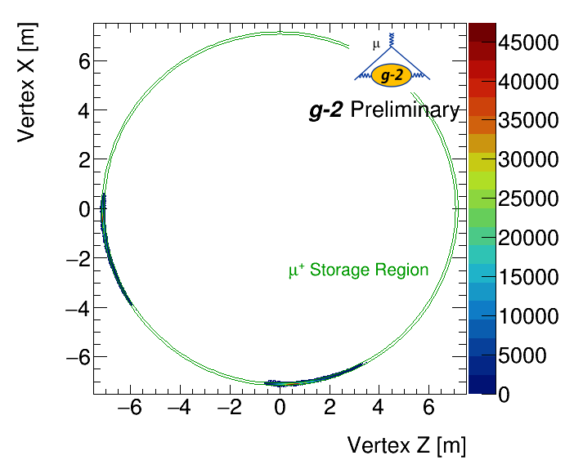
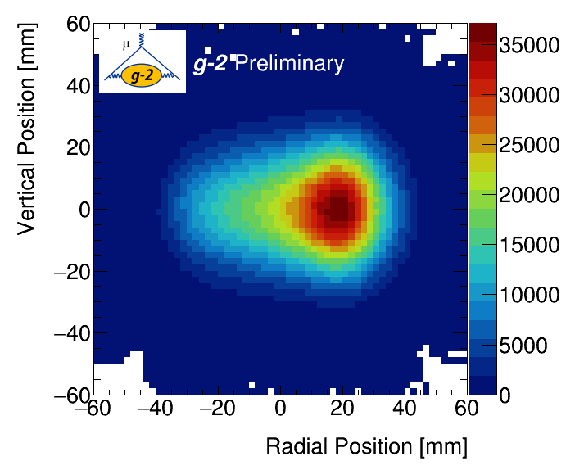
Muon Decay Position
What tracker measures for decay position in the 60h dataset:
Decay Vertices
Radial & Vertical Position
Trackers at
180° & 270°
Top-down view of decay vertices
Projection of beam onto radial slice

Slide 9
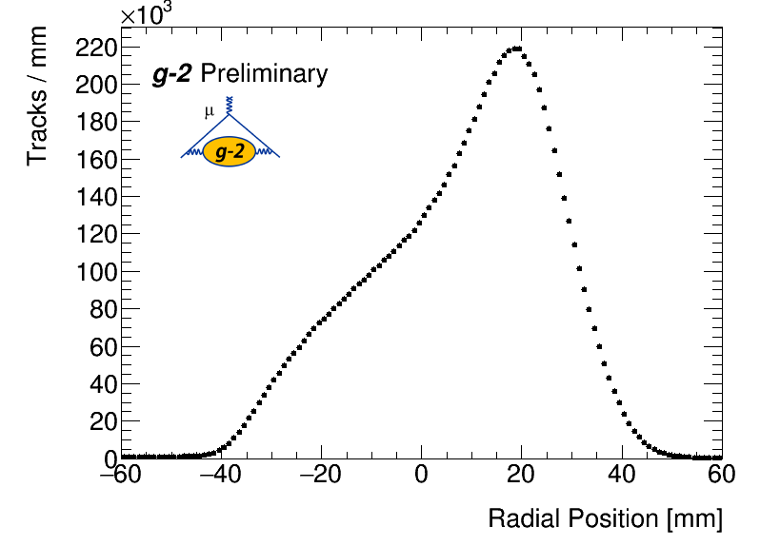
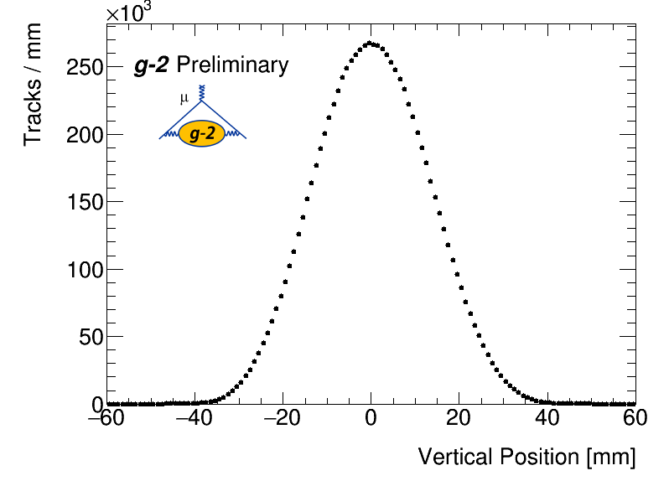
Beam Position: Radial & Vertical Projections
Projections of 2D beam spot from previous slide onto radial and vertical directions:
Decay Position - Radial
Decay Position - Vertical

Slide 10
Non-continuous Quads:
We vertically focus the beam in the quad regions:
Trackers are measuring beam in between quads, so we measure slightly lower width than overall beam
5% difference in width between centre of quads and gaps
Q1
Q2
Q3
Q4
Muons
Tracker measurement region

Slide 11
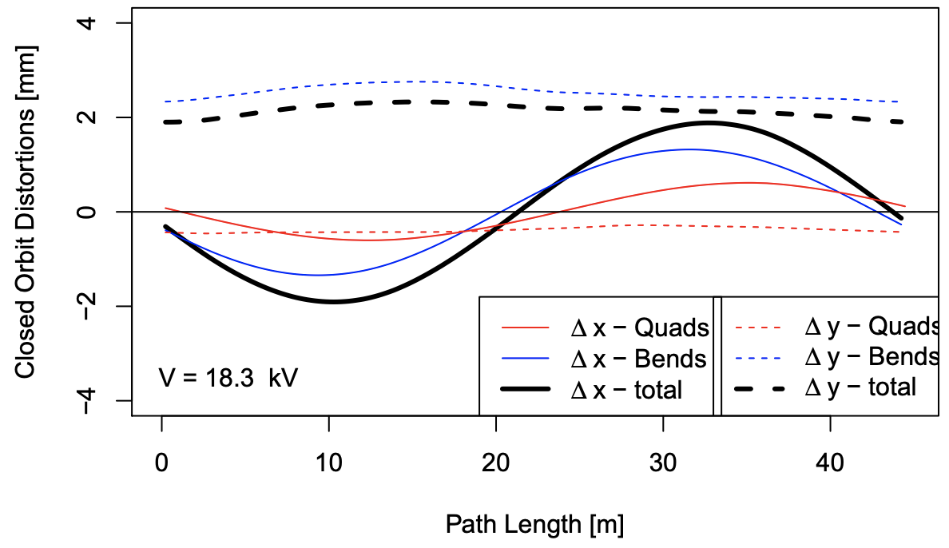
Closed Orbit Distortions
Small misplacements of the quads and radial field lead to change of vertical position around the ring:
How does width change due to these effects?
Radial field changed a lot over run – is this representative?
Plot stolen from Mike Syphers

Slide 12
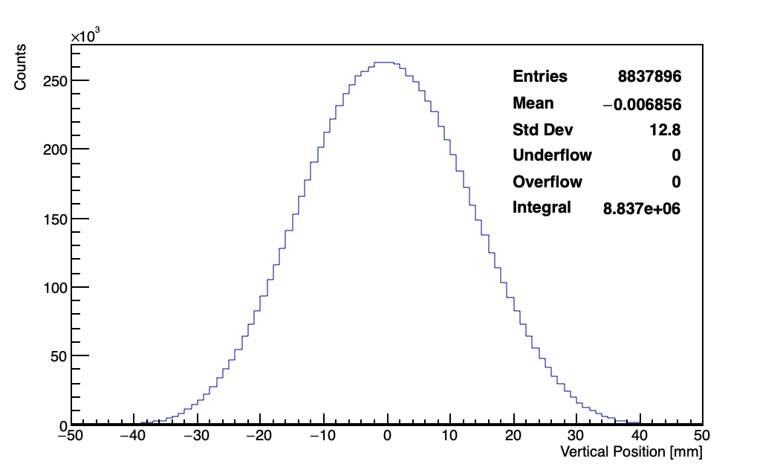
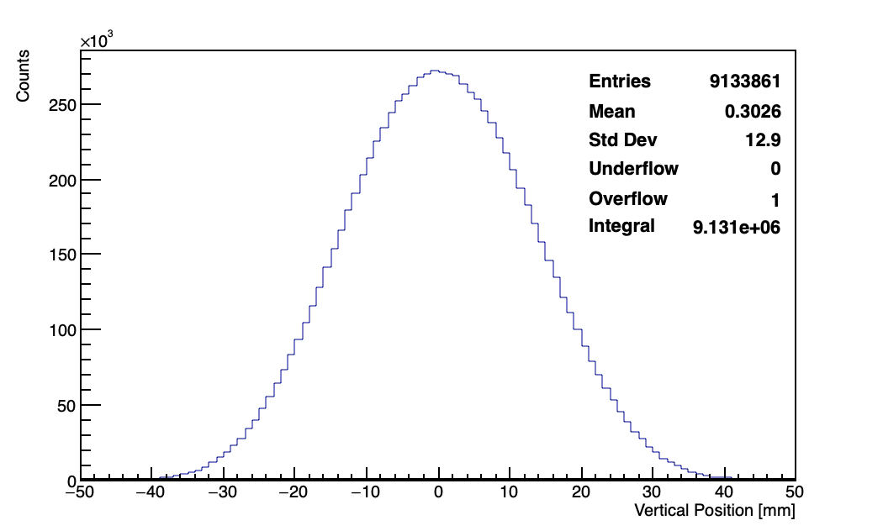
A Recipe for Pitch Correction:
Ingredients:
Tracker data
Beam dynamics (BD) model
Calorimeter acceptance
Steps:
Correct tracker measurements for acceptance & resolution:
Station 12
Station 18

Slide 13
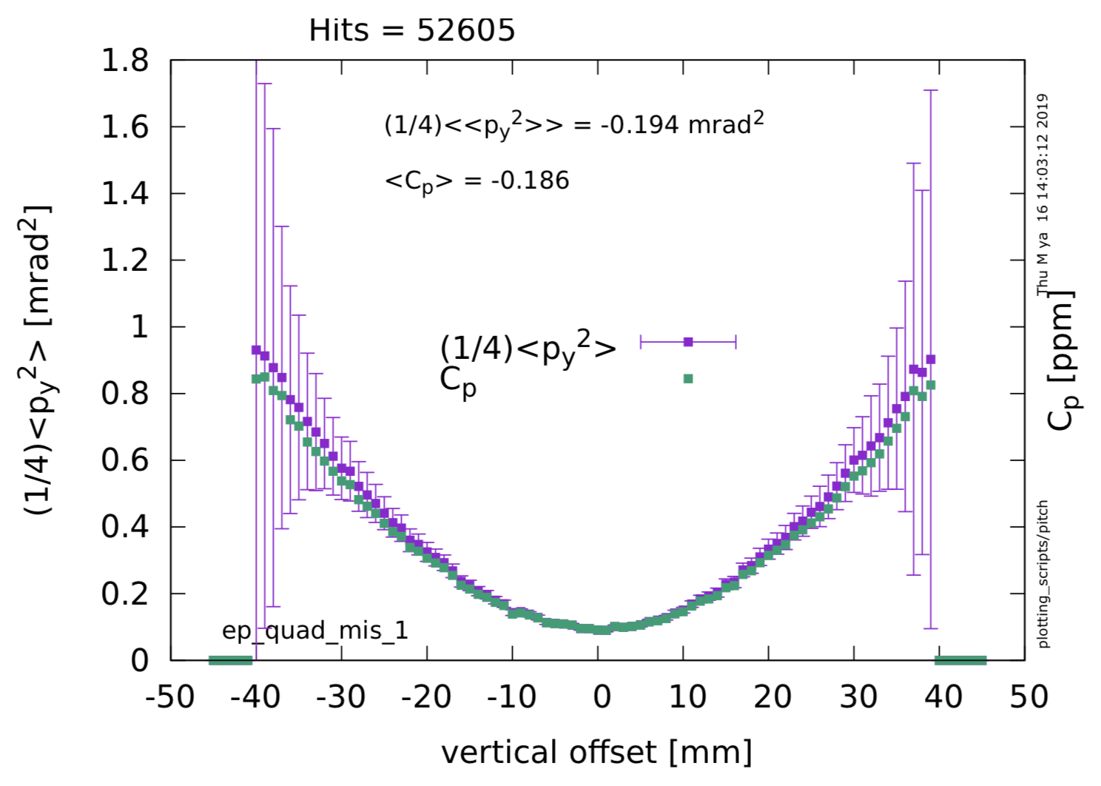
A Recipe for Pitch Correction:
Stolen from David R.
Ingredients:
Tracker data
Beam dynamics (BD) model
Calorimeter acceptance
Steps:
Correct tracker measurements for acceptance & resolution.
Tune BD model to match tracker data at two measurement points
Propagate µ⁺ in model and get C_{P} for each decay

Slide 14
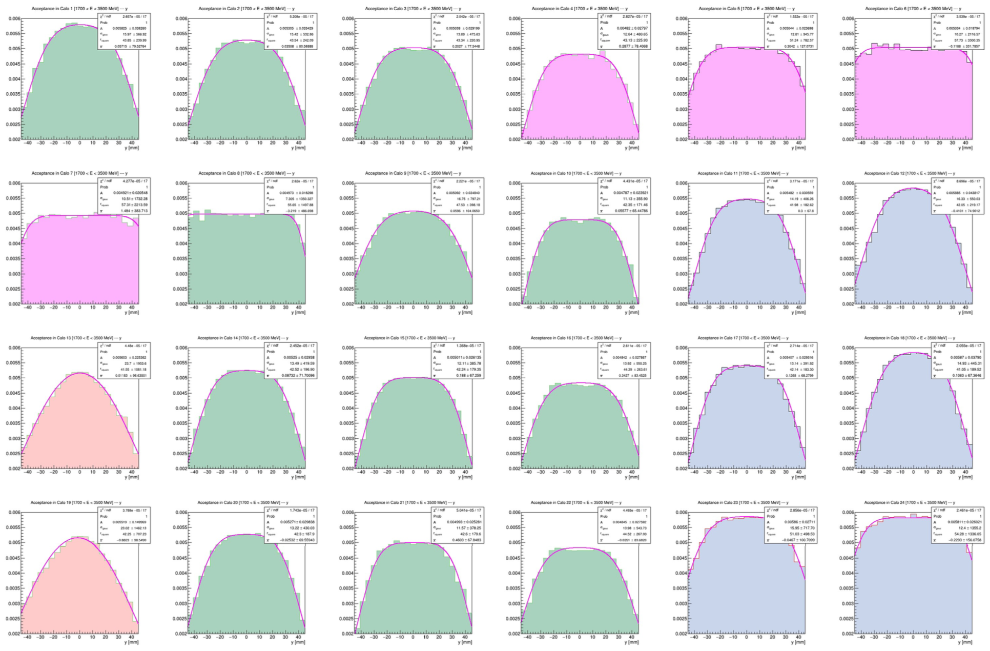
A Recipe for Pitch Correction:
Stolen from Josh
Ingredients:
Tracker data
Beam dynamics (BD) model
Calorimeter acceptance
Steps:
Correct tracker measurements for acceptance & resolution.
Tune BD model to match tracker data at two measurement points
Propagate µ⁺ in model and get C_{P} for each decay
Calculate C_{P} weighted by calo acceptance at each decay point

Slide 15
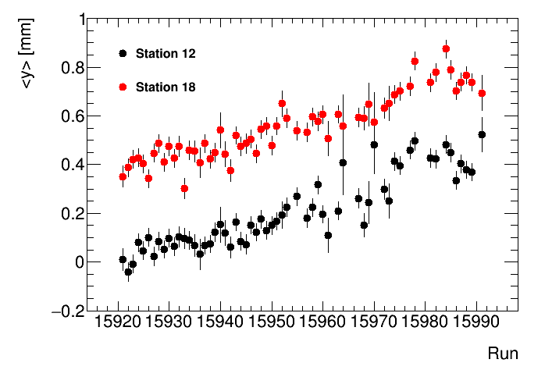
Vertical Distribution: Changes vs Time
DocDB 14071
DocDB 15631
We have 2 effects that could change our vertical distribution
  Changing radial magnetic field means the beam drifts up-and-down over the time scale of hours:
We fit each run separately and combine widths
After alignment
Difference could be from closed-orbit distortions or systematic shift

Slide 16
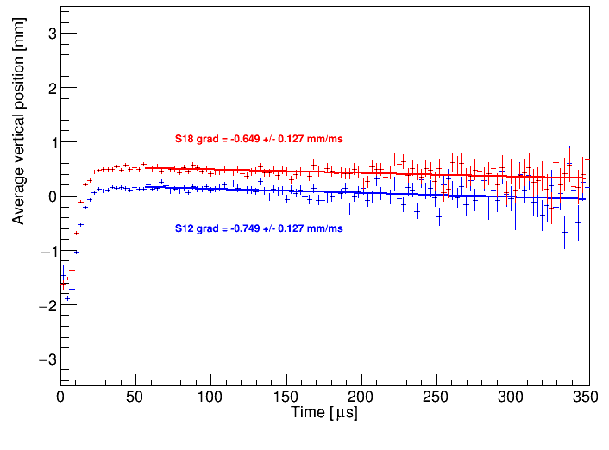
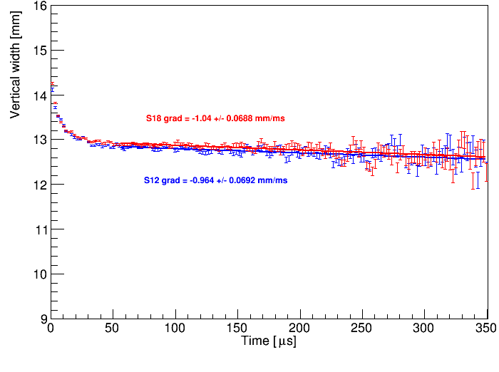
Vertical Distribution: Changes vs Time
We have 2 effects that could change our vertical distribution
  Bad quad resistors mean the beam moves down and changes width over the course of each fill:
Seems to be negligible for width measurement but I raise it here lest we forget
Mean Vertical Position
Vertical Width

Slide 17
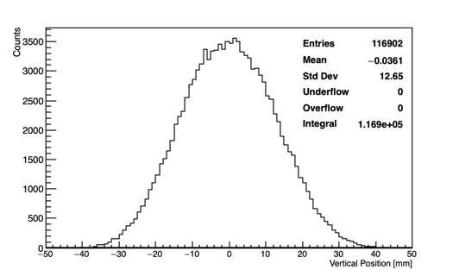
Vertical Distribution: Typical Run
First full run of the 60h dataset (15922):
Per run, have 10⁵ tracks per station after quality cuts
Statistical uncertainty on C_{P} ~1 ppb per run
S12
Run 15922

Slide 18
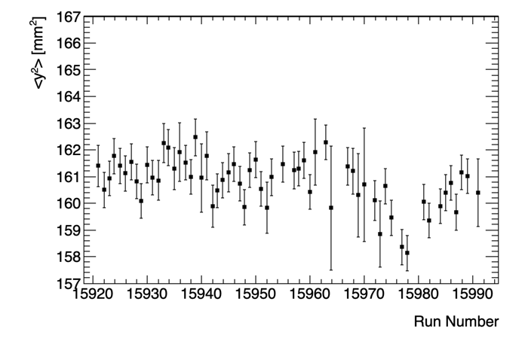
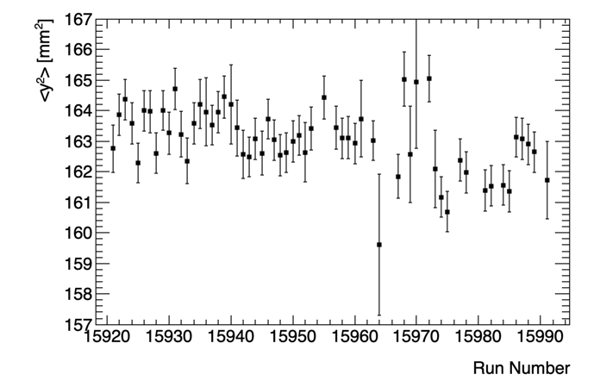
〈y²〉 over 60h dataset:
Sean Foster (BU)
DocDB 17224
Width is stable until run 15970, which is is thought to be related to the quads:
Change after then is only a few ppb different
Difference between stations combination of resolution & orbit distortions
DocDB 15631
Station 12
Station 18
Remember
1 mm² ~ 1 ppb

Slide 19
Tracking Systematics: Intro
Tracking systematics have been computed by whole team:
  Alignment (Gleb, Joe, James)
  Tracking algorithm (Alessandra, Dan, Gavin, James)
  Cross-talk (Dan)
  Lost muons (Sam)
We change parameters and see how µ_{r} , σ_{r} , µ_{y} , & σ_{y} change
Generally, vertical width is not sensitive to most systematics
Details and links to studies in tracking analysis e-log 164
Still missing fringe field estimate

Slide 20
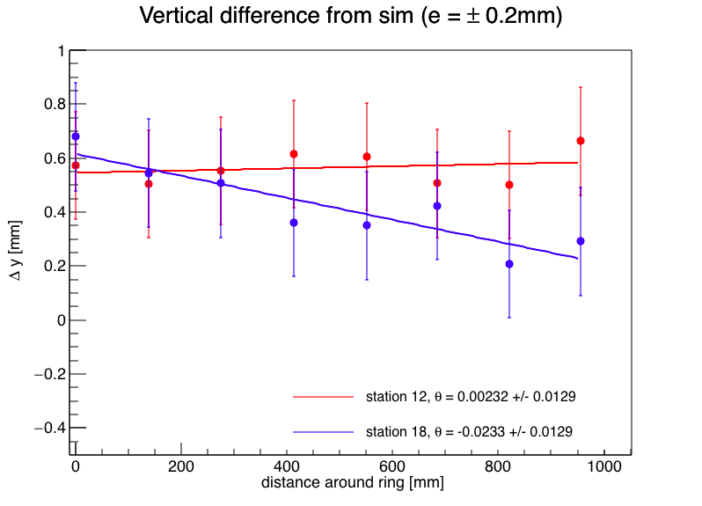
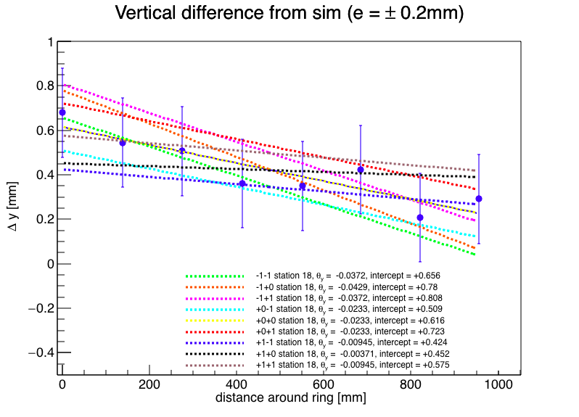
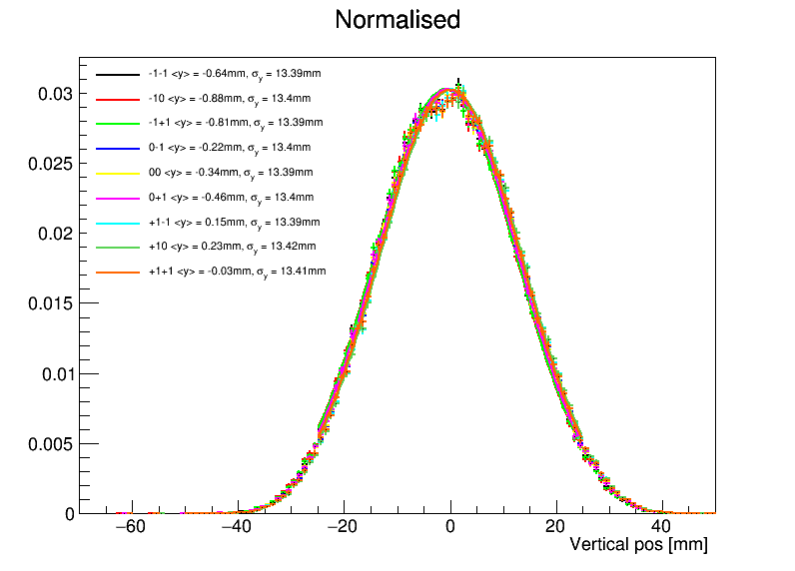
Alignment: External Alignment
Joe Price (Liverpool)
Use Horst’s alignment measurements
Fit for ‘global alignment’
Generate correlated shifts
See doc-db 16063
〈y〉 changes by +/- 0.6 mm, and 〈y²〉 +/- 0.01 mm²
Corresponds to a ΔC_{p} = 0.3 ppb

Slide 21
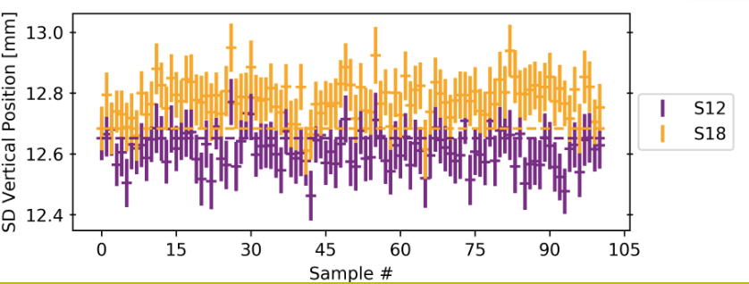
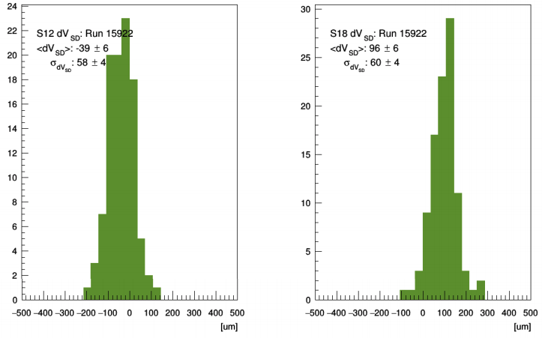
Alignment: Internal Alignment
Gleb Lukicov (UCL)
Internal alignment is the movement of the individual modules in a station
Generate randomly mis-aligned modules +/- 100μm
Reconstruct data and calculate 〈y²〉
Details in doc-db 16685
Δσ_{y} = 0.06 mm, giving ΔC_{p} = 1.5 ppb

Slide 22
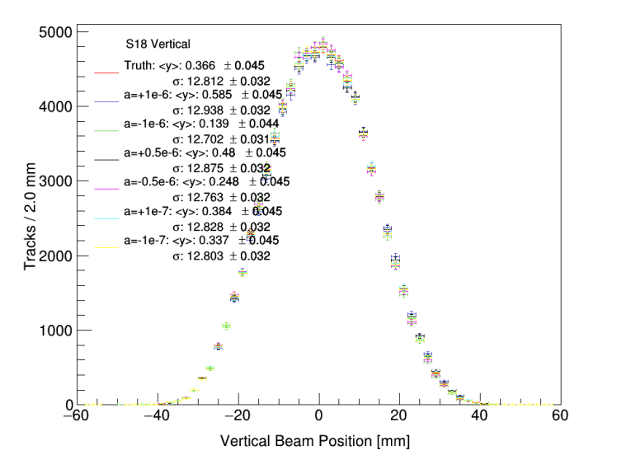
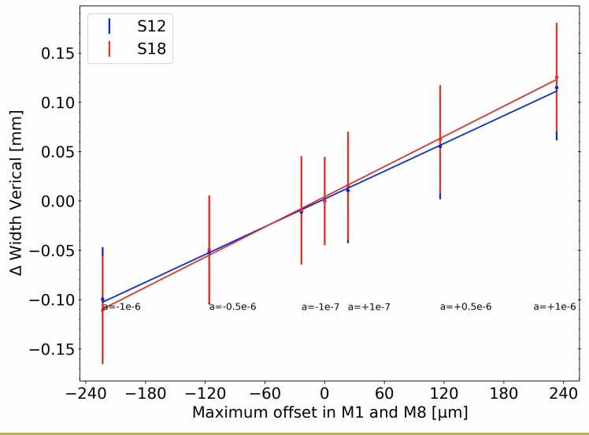
Alignment: Detector Curvature
Gleb Lukicov (UCL)
DocDB 17848
If modules are in a circle rather than straight, we just fit a good quality track with the wrong momentum
This biases track extrapolation:
Δσ_{y} = 0.1 mm, giving ΔC_{p} = 2.7 ppb

Slide 23
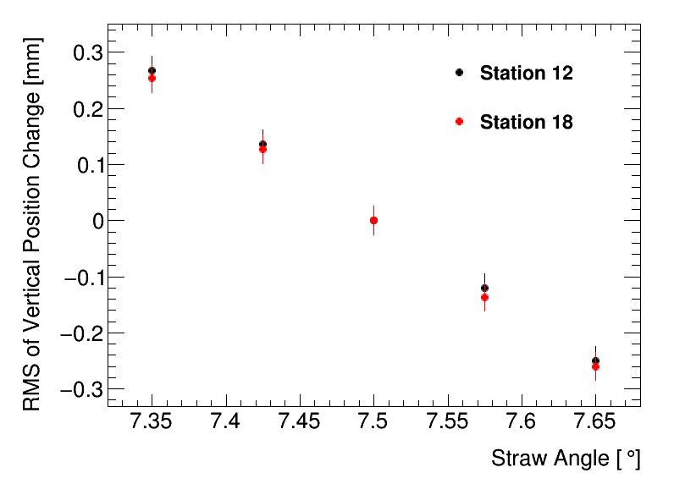
Alignment: Straw Angle Alignment
E-log 175
100 µm
Wire
7.5°
7.65°
Design
Misaligned
Wire position at end of straw known to ~100 µm
Conspiracy theory: all are misaligned in same way due to some machining error
Uncertainty on vertical width of 0.25 mm → ΔC_{P} = ± 6.9 ppb

Slide 24
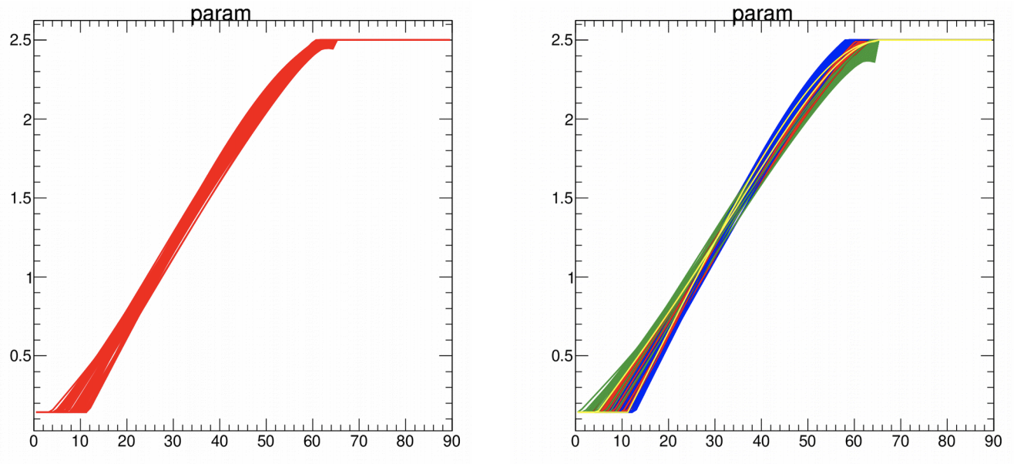
Tracking Algo: T-to-R
Gavin Hesketh (UCL)
DocDB 17746
Have function for going between drift-time and track impact parameter
Changed slope of this curve to that of steepest & shallowest layers:
Δσ_{y} = 0.1 mm, giving ΔC_{p} = 2.7 ppb
DCA [mm]
DCA [mm]
Default Parameterisation
(One line per layer)
Test Cases
Drift Time [ns]
Drift Time [ns]

Slide 25
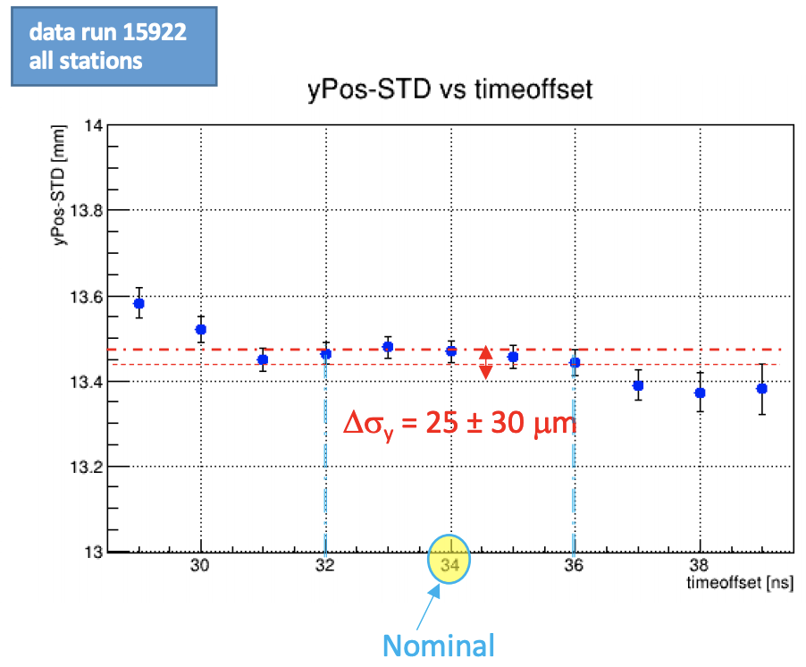
Tracking Algo: t₀ Offset
Alessandra Lucà (FNAL)
DocDB 16787
t₀ offset is fixed time difference between estimate of t₀ and the mean of hits in the track
Getting it wrong increases/decreases the drift circles of the straw hits
Take ± 2 ns as uncertainty
No clear shift in width of y distribution, but we take uncertainty as 25 µm [0.6 ppb]

Slide 26
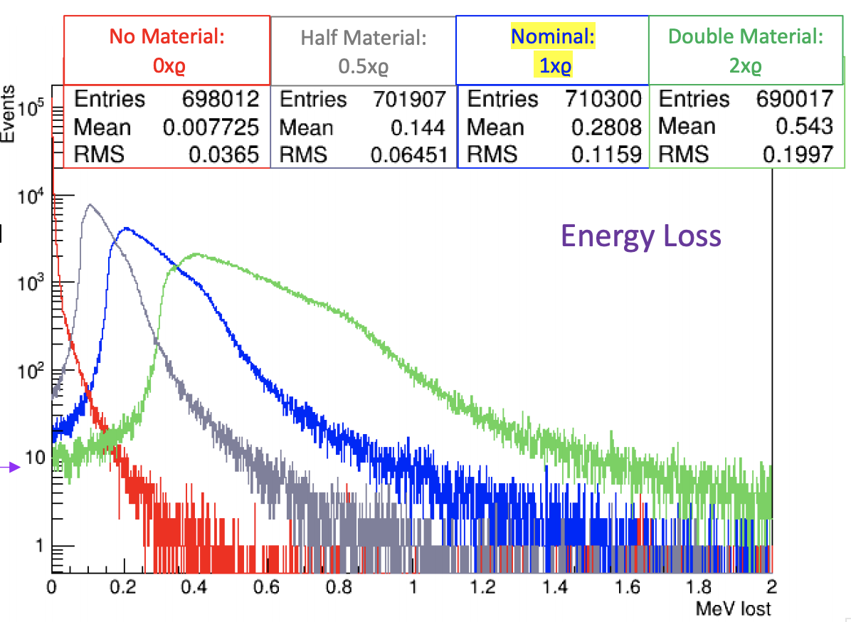
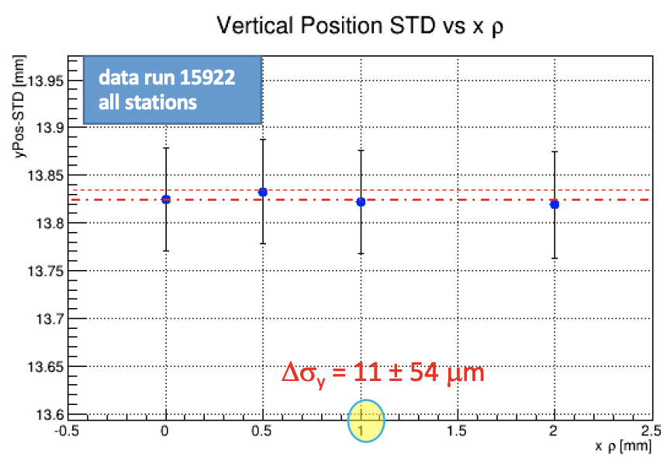
Tracking Algo: Material Density
Alessandra Lucà (FNAL)
DocDB 16787
Amount of material in tracker is used to calculate energy loss
Getting it wrong means we get our track curvature wrong
Tested reconstruction with 0, 0.5, 1, 2x nominal density.
No clear shift in width of y distribution, but we take uncertainty as 11 µm [0.3 ppb]

Slide 27
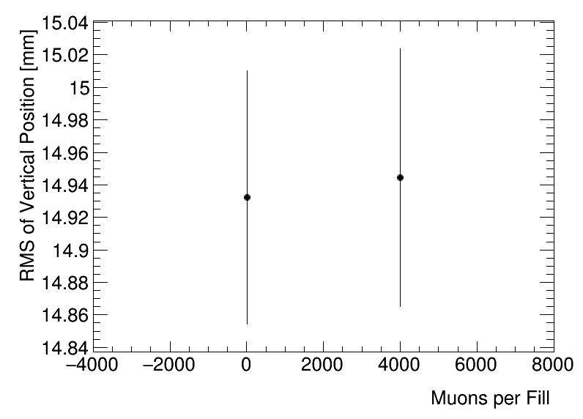
Tracking Algorithm: Track-Finding
E-log 174
Have to choose which straw hits are on the track
Majority of tracks don’t have another track present so effect is small.
Tammy’s working on a more concrete estimate of this and we’ll revisit with refinement
Ran with MC with 1 muon per fill and then 4000 muons per fill (~ Run 1)
Leads to shift in σ_{y} of 10 µm [0.3 ppb]

Slide 28
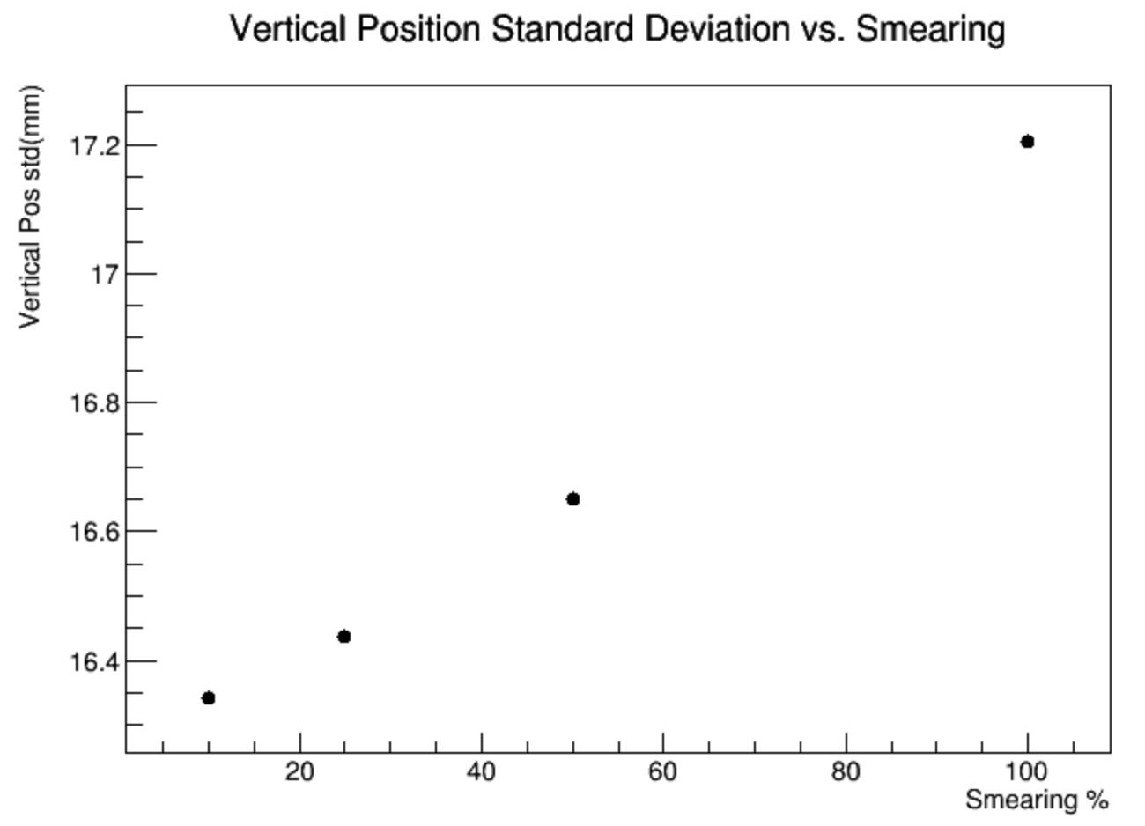
Tracking Algo: Meas. Resolution
Dan Boyden (NIU)
E-log 159
Tuned our reconstruction measurement resolution to data, but we could get it wrong still.
Try smearing positions in data by extra amount
Don’t expect to be wrong by more than 10%: Δσ_{y} : 10 µm [0.3 ppb]

Slide 29
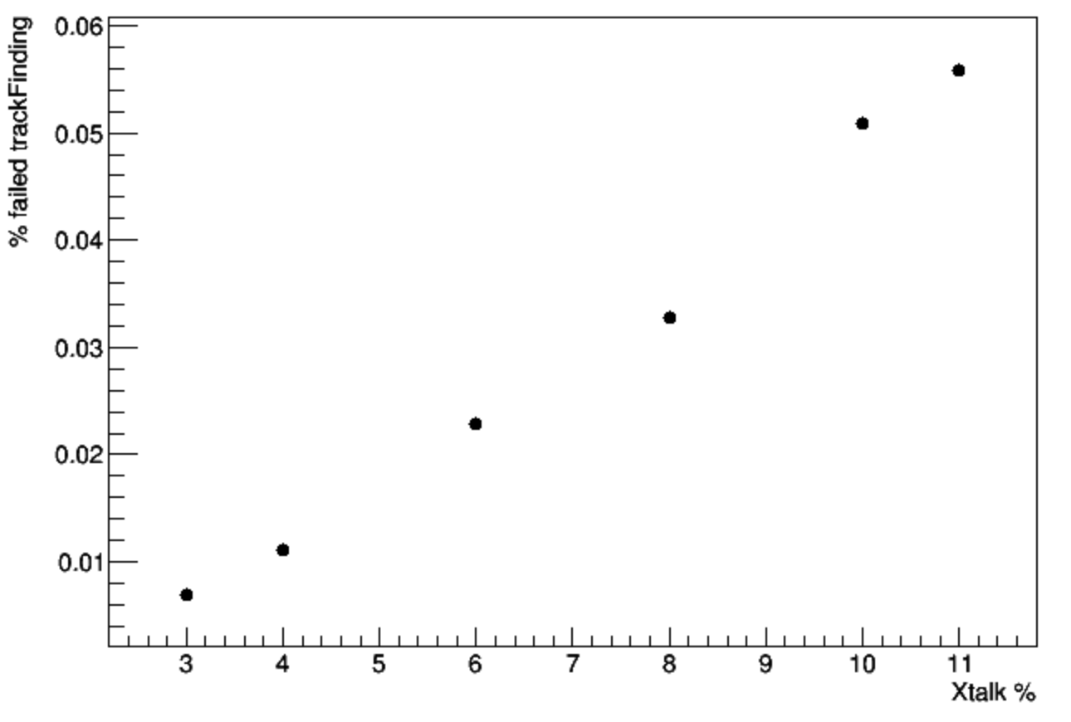
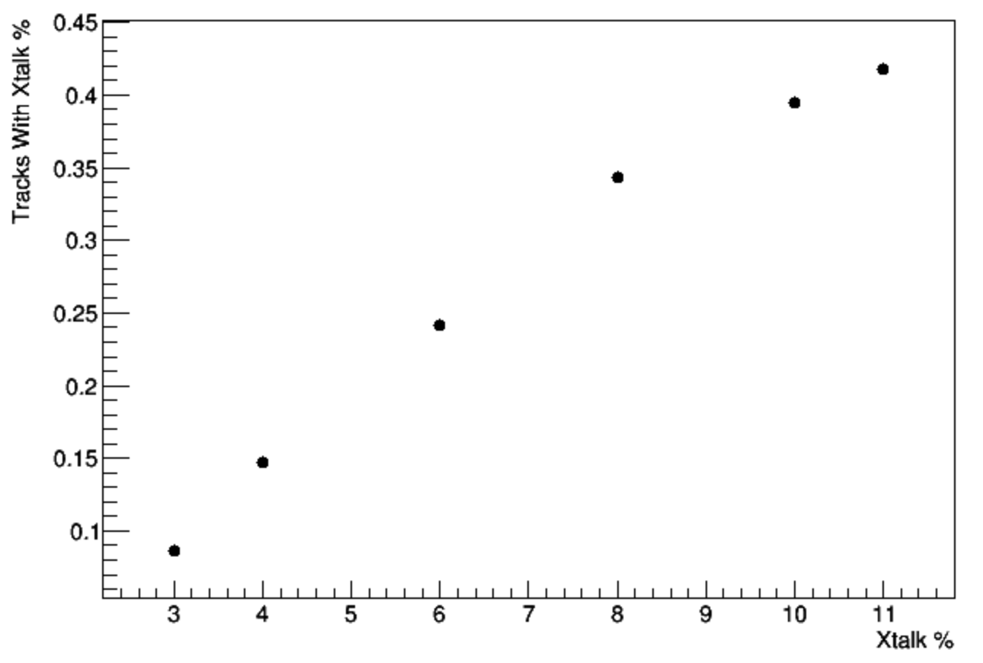
Cross Talk:
Dan Boyden (NIU)
E-log 159
Cross talk adds in hits in the wrong straws at similar times
From data: ~7% of hits generate a cross-talk hit.
Added cross-talk to simulation and studied effect:
No difference seen in extrapolated vertical width after quality cuts.
% of tracks removed by track-finding
% of tracks with cross-talk hits

Slide 30
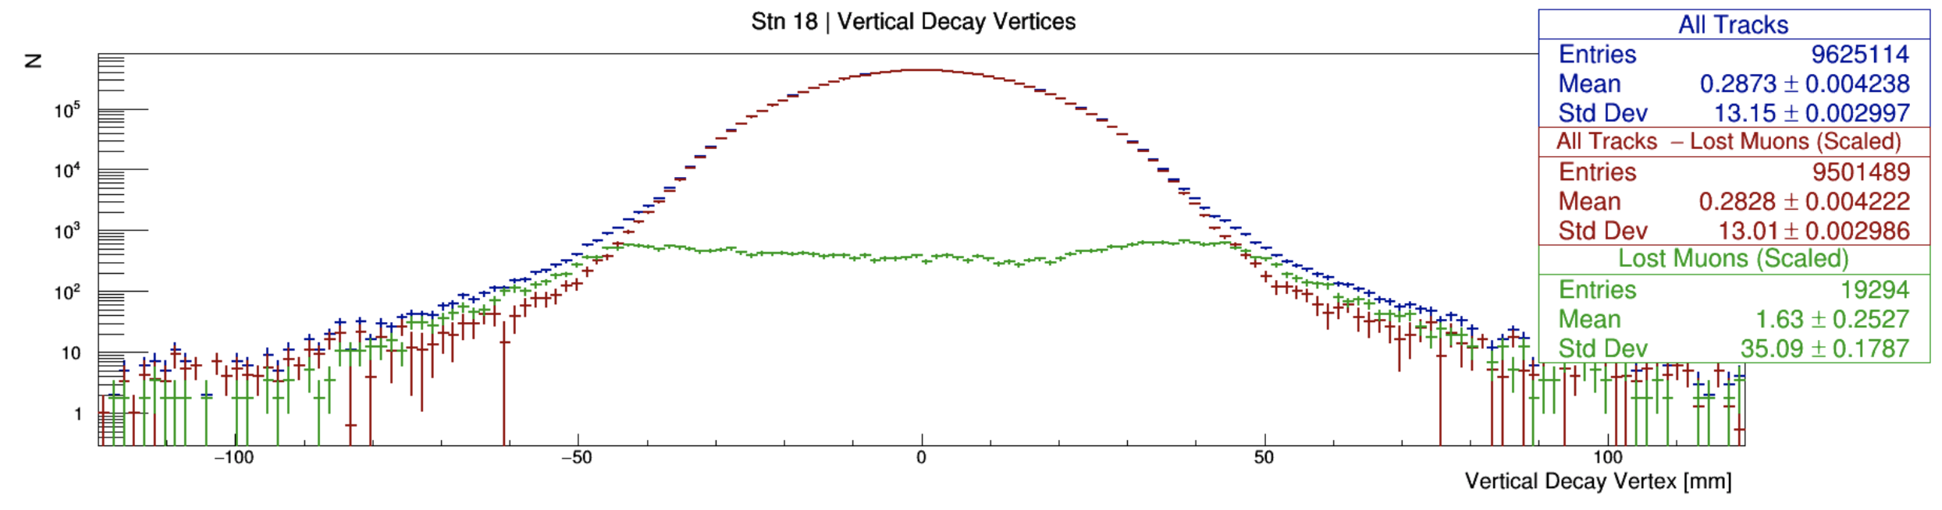
Lost Muons
Sam Grant (UCL)
E-log 159
Lost muons look like high momentum e⁺ in the tracker
Many removed by quality cuts, but some survive.
Estimate how many make it through by using calorimeter to tag e⁺/µ⁺:
± 60 mm Range
[2.9 ppb]

Slide 31
Uncertainties from Tracking:
Systematic | “Volunteer” | σ_{y} systematic [mm] | C_{p} systematic [ppb]
Alignment (Internal) | Gleb | 0.06 | 1.5
Alignment (External) | Joe | 0.01 | 0.3
Alignment (Curvature) | Gleb | 0.1 | 2.7
Straw Stereo Angle | James | 0.25 | 6.9
t₀ | Alessandra | 0.03 | 0.6
Track Finding | James | 0.01 | 0.3
Hit resolution | Dan | 0.01 | 0.3
R to T | Gavin | 0.1 | 2.7
Material Effects | Alessandra | 0.01 | 0.3
Magnetic fringe field | ? | ? | ?
Cross-talk | Dan | < 0.005 | < 0.1
Lost muon contamination | Sam | 0.11 | 2.9
Total |  | 0.32 + ? | 8.6 + ?
Find that all tracking uncertainties together give ~ 9 ppb
Need to make sure last outstanding systematic is not significant
Should be able to check straw stereo angle alignment with tracks

Slide 32
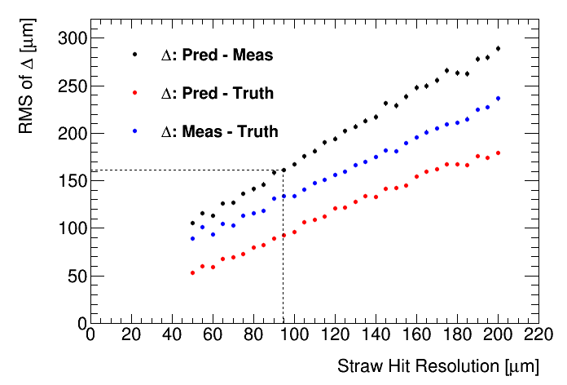
Tracking Resolution
Measurement will include resolution & we over-estimate width
Drop tracker layer from fit and then compare prediction to measurement:
Data matches straw hit resolution of ~95 µm
Hit + t₀ + tracking
Hit + t₀
Hit Resolution
Tracking Res.
Data RMS

Slide 33
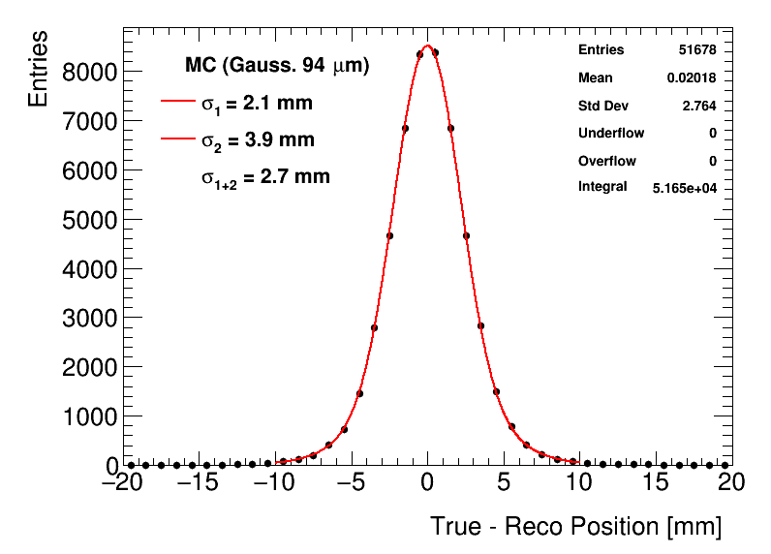
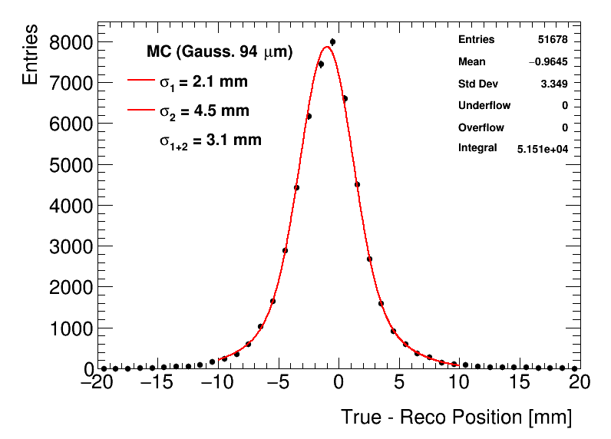
Beam Spot Resolution
Using this resolution in MC, we can follow through tracking and extrapolation to estimate the vertex resolution:
Two different resolutions present so needed two Gaussians.
Combination for vertical resolution is 2.7 mm
Vertical
Radial

Slide 34
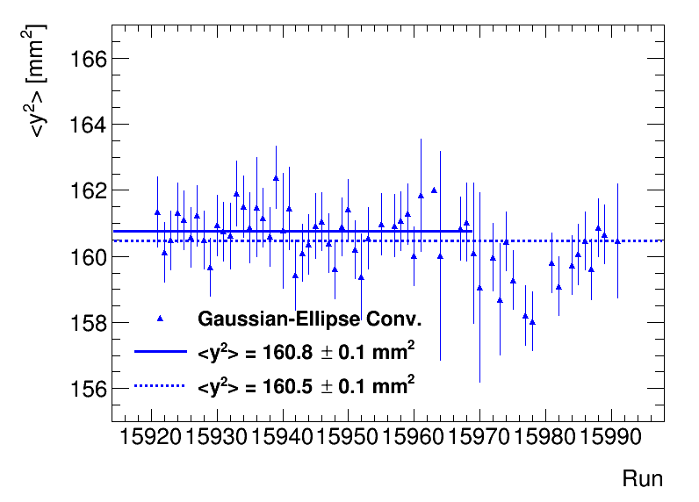
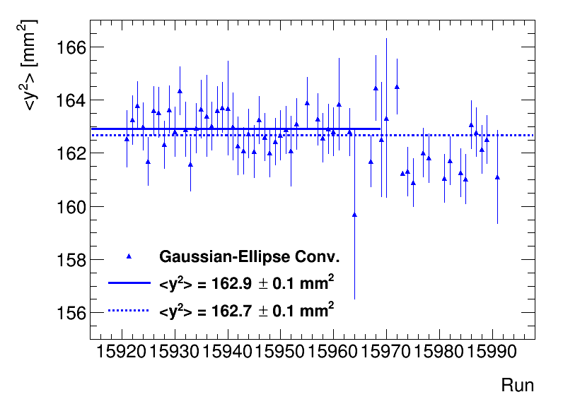
Vertex Resolution Removal: Data
Station 12
Station 18
Remember
1 mm² ~ 1 ppb
Using fit over whole range of 60h:
Relatively small change from resolution (~8 ppb)
Stat. errors only

Slide 35
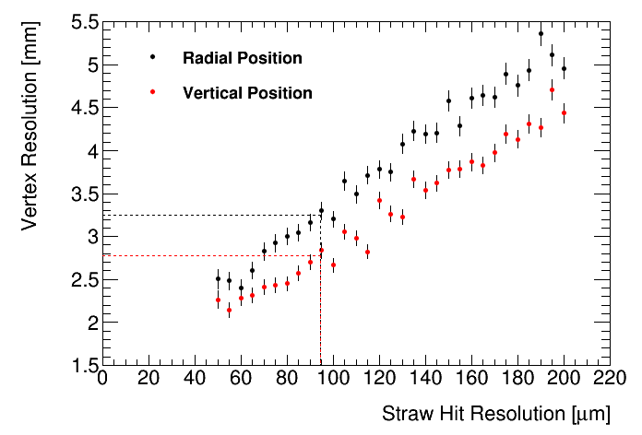
Vertex Extraction Resolution: Systematic
How wrong could our resolution estimate be?
Conservatively, I think we know our hit resolution to ~ 30 µm
Vertical resolution known to 0.5 mm → ΔC_{P} = ± 3 ppb

Slide 36
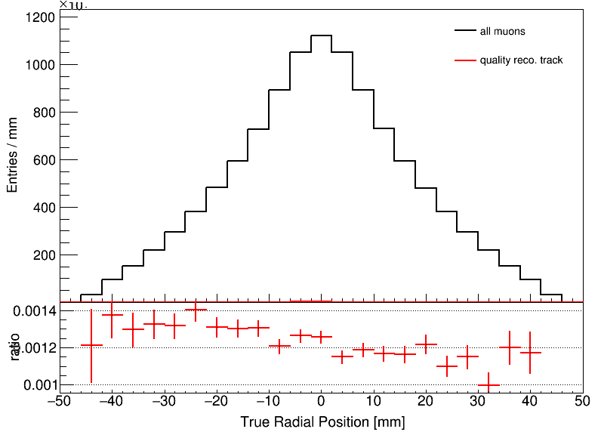
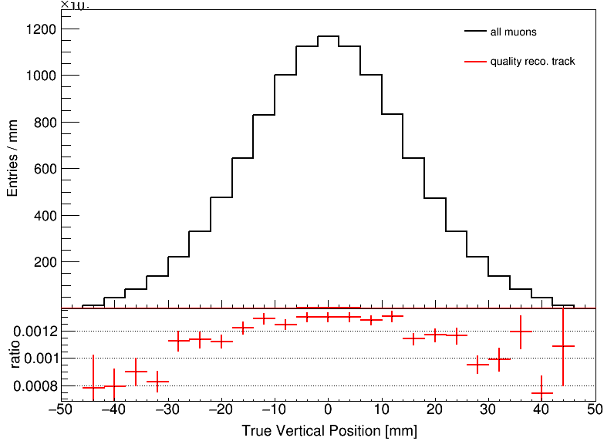
Tracker to beam: acceptance
How does what trackers measure compare to true beam?
See more tracks at lower radius (closer to tracker)
See fewer tracks that decay near top and bottom of ring – means we underestimate vertical width
Radial
Vertical
MDC1
MDC1
Tracks/Truth
Tracks/Truth

Slide 37
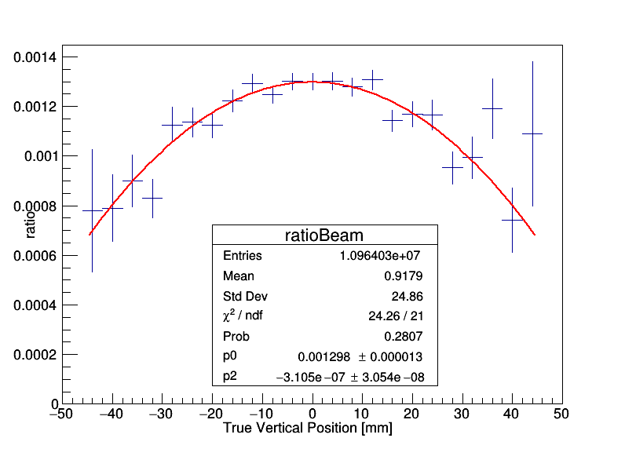
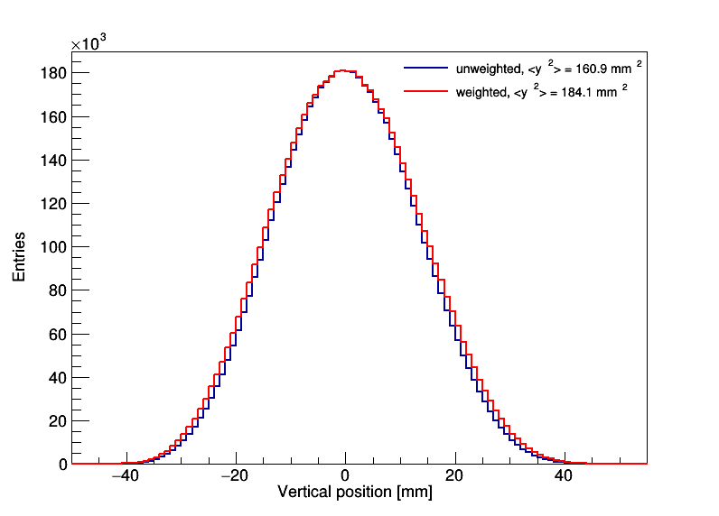
How much do we underestimate width?
Take the tracker measurement and weight it by the acceptance curve (2nd order polynomial fit)
〈y²〉 increases from 161 to 184 mm² [14%]
Including resolution increase is reduced by ~ 3 mm²
Will correct for acceptance & resolution together
Remember
1 mm² ~ 1 ppb

Slide 38
Calo Acceptance: Reminder
Final acceptance effect on calos will be smaller as high/low decays less likely to get into wiggle plot:
Pitch correction still exists even if you decay at y = 0, so we need a model to calculate this properly.
Vertical acceptance by calo

Slide 39
Uncertainties Summary:
Systematic | C_{p} systematic [ppb]
Tracking | 8.6 + ?
Vertex Resolution | 3
Total | 9.1 + ?
Uncertainty excluding acceptance is ~10 ppb
Acceptance correction itself will be less than 20 ppb with small error
Simulation/Model uncertainty is also 10 ppb
Total correction expected to be ~160 ± 15 ppb.

Slide 40
Extra Slides

Slide 41
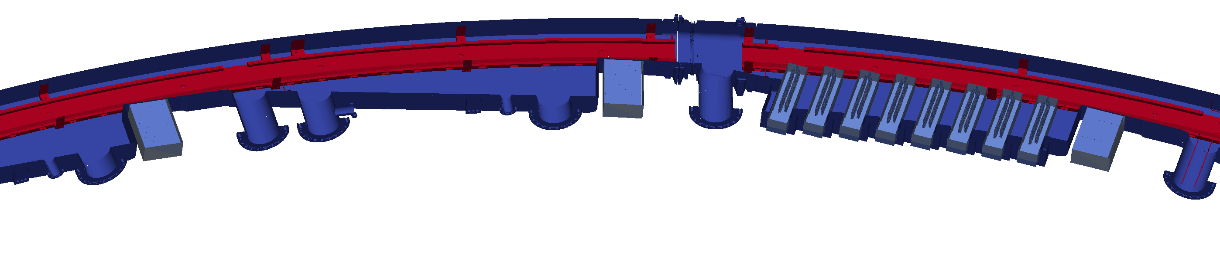


Tracker Design Overview
Two trackers: each with 8 modules that sit in front of calorimeter
Decay e⁺
Top down view of ring section
Vacuum Chamber
Calorimeters
Tracker
Muon’s-eye view inside vacuum chamber
Storage Region
Each module has 128 straws in four layers
(Total tracker has 32 straws x 32 layers)

Slide 42

Track Extrapolation: Decay Point & Calorimeters
We extrapolate tracks backwards to decay point and forwards to calorimeter:
Muon Storage Region
Backwards Extrap.
Straw Hits
Stop extrapolation when momentum is tangential
Calorimeter
Forwards Extrap
Tracker Modules

Slide 43
Tracking & Extrapolation Quality Cuts:
DocDB 16420
DocDB 16444
DocDB 16282
Apply these quality cuts to improve tracking distributions:
Non-failed track/vertex
No volumes hit
Number of Straw Hits >= 12
pValue > 5%
0.5 < σ_{y} < 3.5 mm and 0.5 < σ_{r} < 5 mm
Entrance: 60 < x < 150 mm && -40 < y < 40 mm
0 < Drift Times < 70 ns
Track Residuals < 500 um
Fraction of Missed Layers < 30%
|U - V Hits| <= 4
Extrap Distance > 40 cm
Extrap Distance > -150 cm + |p| * 0.1 cm/MeV
With track refinement we can likely recover a lot of the tracks lost here
Removes 50% of previously accepted tracks
(9 hits, no volumes & p-value > 0.005)
Removes 5%

Slide 44




Tracking & Extrapolation Quality Cuts:
DocDB 16420
DocDB 16444
DocDB 16282
Cuts are very effective at removing tails (which skew y²):
Radial
No Volumes && p-value > 0.5%
With Quality Cuts
Vertical

Slide 45




Tracking & Extrapolation Quality Cuts:
DocDB 16420
DocDB 16444
DocDB 16282
Cuts are very effective at removing tails (which skew y²):
Radial
No Volumes && p-value > 0.5%
With Quality Cuts
Vertical

Slide 46


Tracking & Extrapolation Quality Cuts:
Quality cuts don’t introduce large bias in acceptance:
The true radial and vertical decay positions are equally distributed for quality and non-quality tracks
Radial Position
Vertical Position
Normalised Entries

Slide 47

What’s shape of the distribution?
Sean Foster (BU)
DocDB 17224
We don’t know of a simple functional form for an offset beam in a circular aperture
Single Gaussian doesn’t fit very well:
Data
Run 15922
Don’t mention fit at all – just go to data only!

Slide 48

What’s shape of the distribution?
Sean Foster (BU)
DocDB 17224
Found two different functions that work a bit better:
Neither is a very good fit due to large χ² in the tails, but they both extract the data 〈y²〉 well
Convolution seems better motivated, but parameters aren’t physically meaningful
Sum of two Gaussians
Ellipse and Gaussian Convolution

Slide 49

What’s shape of the distribution?
Sean Foster (BU)
DocDB 17224
Both fits and data-only give very similar 〈y²〉 results:
Change after 15970 is thought to be related to the quads.
Only a few ppb different from main body of data
Station 12
Remember
1 mm² ~ 1 ppb
DocDB 15631

Slide 50

Tracking Algo: L/R Ambiguity
Alessandra Lucà (FNAL)
DocDB 16787
We don’t know if track went on left or right of wire
Tested using MC – effect of getting wrong L/R estimated as 2.3 mm increase in resolution for each track:
Right Guesses
Wrong Guesses
Should be included in our MC resolution estimate, but we very conservatively assume its totally missed
Leads to shift in σ_{y} of 240 µm [6.9 ppb]

Slide 51

Pitch Systematics: Moving Beam Mean
Tracking e-log 153
We know beam was moving down over course of fill
Estimated effect with ToyMC (with realistic estimate of movement & lifetime):
Width unchanged: assume effect on y² is negligible

Slide 52

Pitch Systematics: Moving Beam
Tracking e-log 154
Width was changing too! Do similar estimate:
Width changes by less than 0.5% [0.8 ppb].
Not sure if we should be taking the changing value anyway so no correction applied

Slide 53


Vertex Resolution Removal: MC Example
Closed-loop test of resolution removal using MDC1 MC:
Truth: σ = 14.2 mm 〈y²〉 = 201.6 mm²
Reco: σ = 14.5 mm 〈y²〉_{meas} = 210.2 mm²
Resolution: σ = 2.7 mm → 〈y²〉_{calc} = 203.0 mm²
Tracks that I reconstructed (ignoring acceptance here)
True
Reco
Works to ~0.6%

Slide 54
Future Plans:
Here’s what’s on our current y² to-do list:
  Finish fringe field
  y² vs angle measurement (acceptance is worse for angle)
  A few cut scans (momentum, p-value, time)
  Closed-loop test with gm2ringsim
  All other datasets (not just 60h)
  Calo acceptance for all calorimeters
  Double-check recon east/west acceptance
    Elephants in the room that we’ve not spoken about:
      How do we measure n?
      Radial magnetic field

