Slide 1
Momentum acceptance model
David Rubin
Cornell University
November 3, 2021

Slide 2
Trajectories in pictures
Momentum acceptance (idealized)
Kick and correlation
Injection angle and field index
Big picture

Slide 4
free betatron oscillation
Continuous quad approximation
invariant amplitude

Slide 5
Kicker – changes the amplitude of the oscillation
Ideal kick zeros betatron amplitude
Assumptions
Continuous quads
Distributed kickers approximated as a
  thin kick
  located at

Slide 6
What is the Ideal Kick ?
At the inflector exit (s=0)
Then
and the appropriate kick is

Slide 7
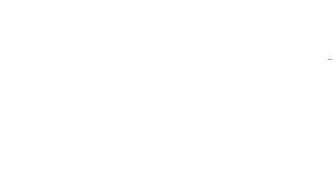
Off momentum
At the inflector exit
where
Fractional momentum offset , about equilibrium (closed) orbit
The muon with equilibrium radius
is over kicked by the ideal kick,
If , the muon is lost on the
collimator at radius A
Collimator at radius A = 45 mm

Slide 8
Off momentum and
If ,
the muon is lost on the
collimator at -A

Slide 9
Off momentum
At the inflector exit
Fractional momentum offset , about equilibrium (closed) orbit
where

Slide 10
Weak kick
At ,
Suppose
Then the ideal kick for that momentum is

Slide 11
Maximum momentum offset and minimum kick
The ideal (only) kick for that momentum is

Slide 12
Minimum momentum offset and maximum kick
The ideal (only) kick for that momentum is

Slide 13
Momentum acceptance vs kick
With the following approximations
Injection angle = 0,
Phase at kicker
Continuous quads
Displacement at inflector
And as long as ,
The minimum kick captures momenta in the range
and
The maximum kick captures momenta in the range
The ideal kick (the kick that steers the magic momentum onto the magic radius) captures momenta in the range

Slide 14
Our inequality gives us the momentum acceptance as a function of kick
Momentum bite versus time of captured particles
Time dependence of kicker field and injected pulse
Field index = 0

Slide 15
acceptance
If we assume the momentum distribution is gaussian with we can compute the average and width of momenta in each time slice
Field index = 0
B_{peak} =204 G

Slide 16
Bigger kick
Time momentum correlation increases with higher kicker field.
Field index = 0
B_{peak} =264 G

Slide 17
Generalize to include dependence on
kicker phase
injection angle
How does the kicker change the trajectory?
FBO initiated by kicker
FBO after kicker
FBO before the kicker
+
=
FBO – free betatron oscillation

Slide 18
Trajectory after the kick

Slide 19
Amplitude of FBO
Before the kicker
After the kicker

Slide 20
Amplitude and injection angle
Assumptions
Phase at kicker,
Momentum offset = 0
Injection angle
Injection offset
amplitude
If a nonzero injection angle reduces acceptance.
There is no kick that zeros the betatron amplitude

Slide 21
Betatron Phase at the kicker – what about ?
Kicker midpoint is physically located 90 deg around the ring from the inflector
The betatron phase at the kicker is
If n=0, If n = 0.108 then
Since
To minimize amplitude when
and
We find minimum amplitude after the kick, when
Set
And
and

Slide 22
For n>0
An inward injection angle reduces the betatron oscillations of the stored beam!
Optimum injection angle

Slide 23
Dependence of betatron amplitude on injection angle for n>0
Assumptions
Phase at kicker,
Momentum offset = 0
Injection offset
Optimal injection angle vs field index

Slide 24
Momentum acceptance
If so that , and
And as long as
and for all kicks
For the ideal kick,
momentum acceptance is
The momentum acceptance for amplitude is

Slide 25
Momentum acceptance
Muon is captured if
In general the trajectory after the kicker
=>
Rearrange to give the momentum acceptance in terms of initial conditions and the kick
is the collimator aperture
The momentum acceptance for amplitude is

Slide 26
How is kick temporal width included?
Inequality that defines momentum bite is generalized to include kicks on multiple turns with the replacement

Slide 27
Thin kick => Distributed kick
The kicker extends over nearly 5 meters.
Model the extended kick by replacing the single kick with 6 kicks each with 1/6 strength and located in the middle of the first and second half of each kicker
from inflector exit
s₆
s₂
s₁
Distributed kicks
Single kick
There is an equivalent kick and an equivalent injection angle

Slide 28
Now our momentum acceptance inequality includes effects of
Physically distributed kick
Kicker pulse width
Injection angle and offset
Kick angle
field index

Slide 29
Averaging over injection angle
If we suppose that the distribution of injection angles is gaussian with a central value,
then

Slide 30
Examples
Effect of kicks on multiple turns
Single kick on first pass
(as good as it gets)
Kicks on 8 passes
Acceptance is reduced on each pass

Slide 32
More examples
Kicker amplitude
B_{peak} = 204 G
B_{peak} = 264 G

Slide 33
More examples
kicker pulse shape
B_{peak} = 204 G
B_{peak} = 294 G
run 3b_4 pulse

Slide 34
Approximations and limitations
We have assumed
Continuous quads
Uniform kicker field and infinite aperture
Continuous collimation
No vertical motion
Neglected to average over injection offset and rely on the average value
Neglect scraping

Slide 35
Conclusions:
Width of accepted momentum bite is nearly independent of kick (as long as the kick is above threshold)
Centroid of the accepted momentum bite decreases with increasing kick
Accepted momentum bite narrows with increasing injection angle (away from ideal value)
The kicker pulse extends over multiple turns. The effect of the multiple kicks is to ‘flatten’ the pulse and reduce the dependence of momentum on time.
Finite kicker aperture reduces acceptance of high momentum particles.
Details of collimation are important as they determine impact of secondary ... kicks

Slide 36
END

Slide 37
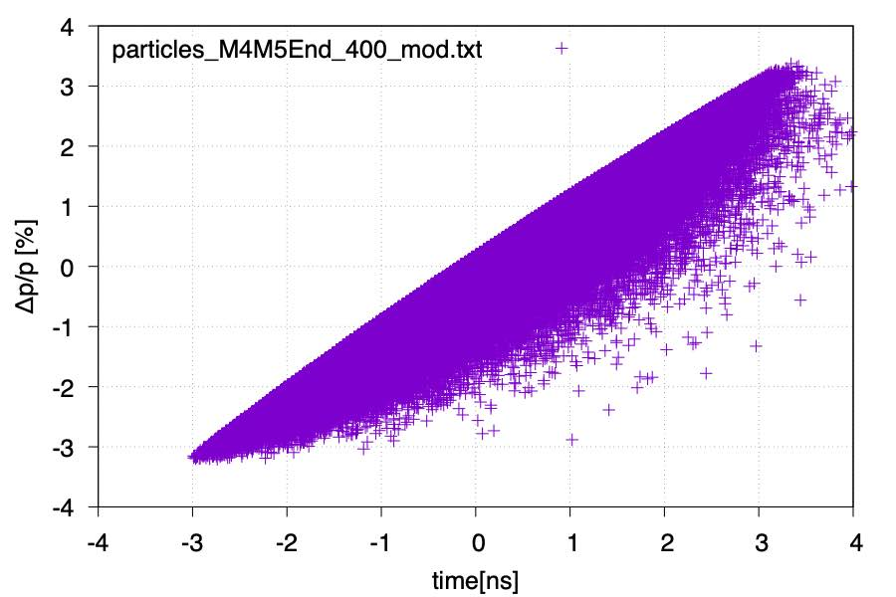

Slide 38
Trajectory of injected particle
At the inflector exit
Write initial phase offset in terms of initial x and x’
Trajectory in terms of initial conditions and betatron phase

Slide 39
Kicker
At the kicker
Displacement and angle at the kicker
Immediately beyond the kick (imagine an infinitesimally thin kicker)

Slide 40
18 mm
inflector
s
kicker
The ‘ideal’ magic momentum muon, exits inflector at its midpoint, straight ahead
As long as , the ideal kick, , steers the ideal muon onto the magic radius.
That muon is stored with zero betatron amplitude.

Slide 41
Kicker field is not uniform across the aperture
Kicker field in midplane
whereas the model assumes the kick is independent of displacement

Slide 43
Kicker aperture
Because of the finite kicker aperture,
the model will overestimate acceptance of high momentum muons.

Slide 44
The kickers have a finite aperture
Magic momentum muon enters kicker #1 displaced ~ 22 mm from magnet axis
inflector
s
kicker
Muons with high momentum and/or angle will miss part or all of kicker #1.
inflector
s
kicker

Slide 46
Field index = 0
B_{peak} =204 G
kicks at
where s_{i} are the locations of the kicks

Slide 47
Multiple kicks and finite injection angle
Field index = 0
B_{peak} =204 G
Sum kicks on first 9 passes through kicker

Slide 48
Extended kicker pulse alters momentum time correlation
Field index = 0
B_{peak} =204 G
Sum kicks on first 9 passes through kicker
Assumes no collimation for first 9 turns

Slide 49
Finite injection angle decreases momentum acceptance (and correlation)
Field index =0
B_{peak} = 204G
Angular distribution of injected particles from simulation

Slide 50
Momentum acceptance
(remember that amplitude depends on momentum)
Rearrange to give the momentum acceptance in terms of initial conditions and kicks
If the injection angle is zero and the kick is chosen to zero for the magic momentum,
Then
injection angle reduces momentum acceptance
(Here and )

Slide 51
if

Slide 52
Kick angle is chosen to reduce the betatron amplitude
Betatron amplitude beyond the kicker
The amplitude is a function of
The kick and the kick phase can be chosen such that
If and , the amplitude beyond the kicker is zero if
If , the kick that minimizes amplitude is always greater than

Slide 53
Invariant amplitude
The betatron amplitude
The betatron amplitude on exit from the inflector

Slide 54
Some Definitions
18 mm
inflector
s
kicker
inflector
kicker

Slide 55
Generalize to include dependence on
kicker phase
injection angle
FBO initiated by kicker
FBO after kicker
FBO before the kicker
+
=
FBO – free betatron oscillation

Slide 56
Injection angle
Injection angle
The minimum kick captures momenta in the range
Injection angle shrinks momentum acceptance
The maximum kick captures momenta in the range
Momentum acceptance vs kick
The ideal kick (the kick that steers the magic momentum onto the magic radius) captures momenta in the range

Slide 57
Momentum acceptance
If so that , and
If
And as long as ,

