Slide 1
Differential Decay and Spin-Coordinate Correlation
&
Characteristic of injected beam at inflector exit
&
Determined by momentum acceptance of ring
Crnkovic et al. doc-db 3477

Slide 2

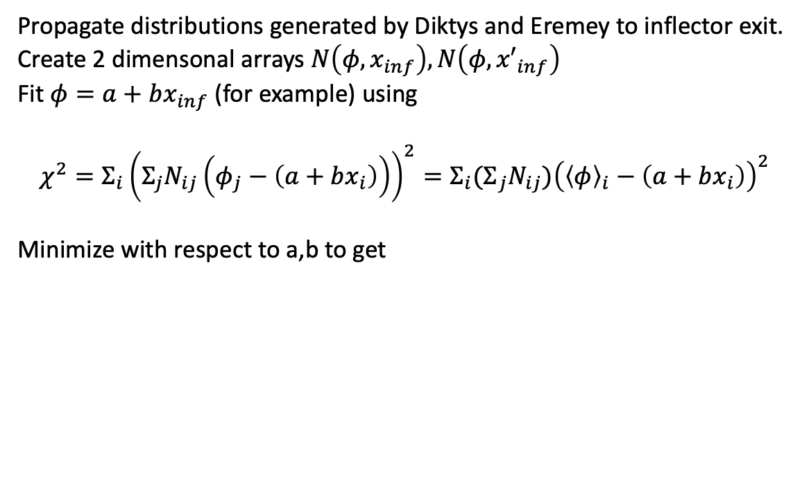
&
Characteristic of injected beam at inflector exit. Correlations arise in pion decay channel
Propagate distributions generated by Diktys and Eremey to inflector exit.
Create 2 dimensonal arrays $N\left(φ,x_{inf}\right),N\left(φ,{x′}_{inf}\right)$
Fit $φ=a+bx_{inf}$ (for example) using
$$χ^{2}=Σ_{i}{\left({Σ_{j}N}_{ij}\left(φ_{j}−\left(a+bx_{i}\right)\right)\right)}^{2}=Σ_{i}{(Σ}_{j}N_{ij}){\left({\left\langle φ\right\rangle }_{i}−\left(a+bx_{i}\right)\right)}^{2}$$
Minimize with respect to a,b to get
$$⟨φ〉$$

Slide 3
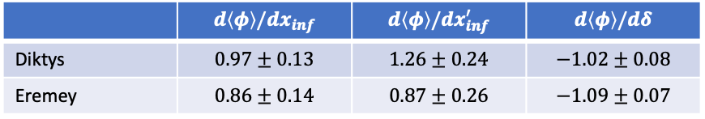
Propagate distribution through the injection channel to the inflector exit.
Correlations of with x, x’ and δ
particles_M4M5End_400_mod.txt”(doc-db 16724 –Stratakis)
φ_{a} - x
φ_{a} – x’
φ_{a} - δ
EndofM5_Valetov_withInit.dat doc-db 17800
φ_{a} - δ
φ_{a} - x
φ_{a} – x’
 | $$d\left\langle φ\right\rangle /dx_{inf}$$ | $$d\left\langle φ\right\rangle /{dx}_{inf}^{′}$$ | $$d\left\langle φ\right\rangle /dδ$$
Diktys | $$0.97±0.13$$ | $$1.26±0.24$$ | $$−1.02±0.08$$
Eremey | $$0.86±0.14$$ | $$0.87±0.26$$ | $$−1.09±0.07$$

Slide 4

Particle tracking to construct , $N\left(x_{inf},δ\right)$and $N(x_{inf}^{′},δ)$
Track particles with temporal distribution as per measured T0 through the injection channel and into the ring
Peak kicker field is 264 G (Run3b-4)
Use measured kicker and muon pulses
Assemble 2 dimensional arrays of particles that survive at least 4 us, $N\left(x_{inf},δ\right)$and $N(x_{inf}^{′},δ)$
Kicker
muons

Slide 5
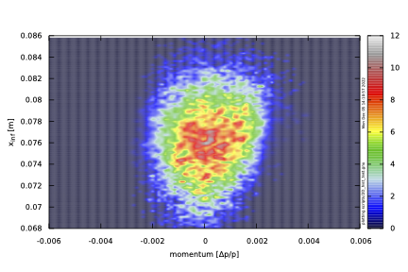
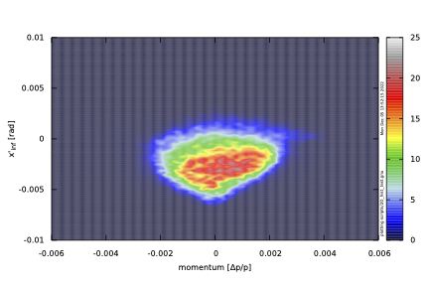


Track particles (Diktys distribution) through the injection channel and into the ring (created)
Peak kicker field is 264 G (Run 3b-4), Measured kicker pulse shape.
Compute offset and angle at inflector vs fractional momentum offset for particles that survive at least 4 us
  config_032
$$N(x_{inf},δ)$$
$$N(x_{inf}^{′},δ)$$

Slide 6
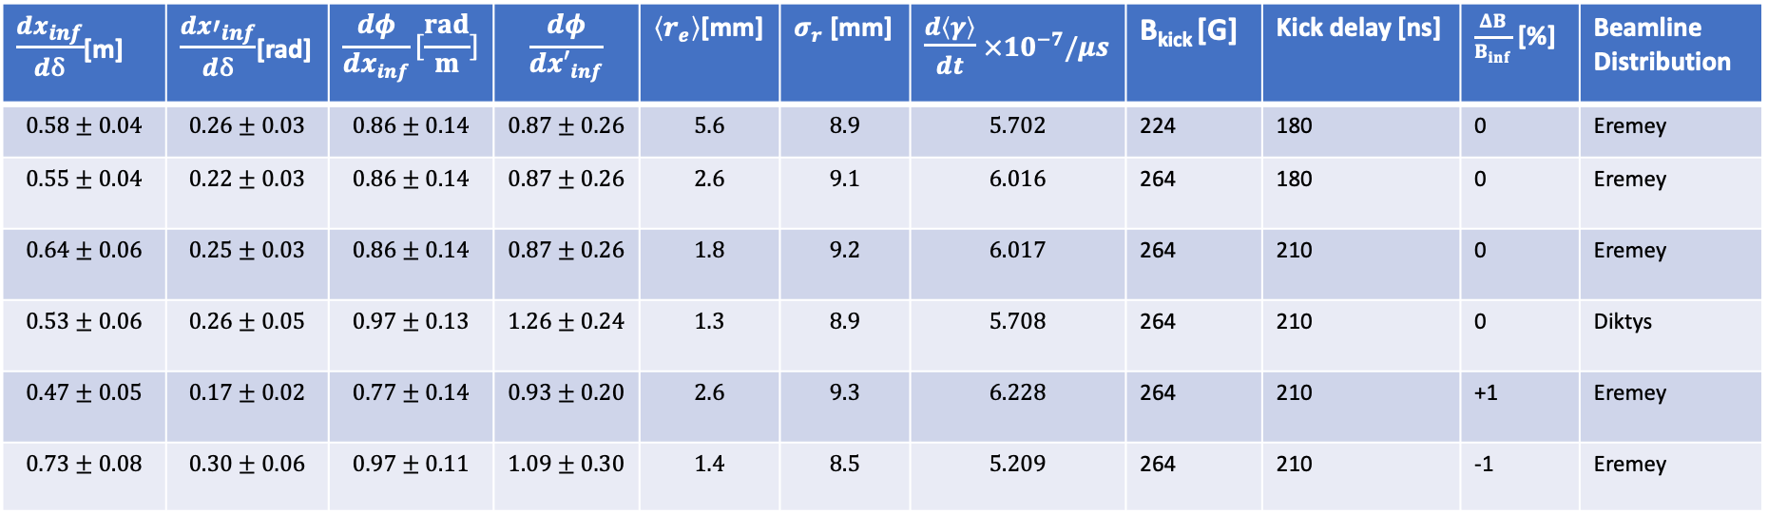
Dependence on kicker field,timing, inflector field, beam line distribution ?
$\frac{dx_{inf}}{dδ}$[m] | $\frac{d{x′}_{inf}}{dδ}$[rad] | $$\frac{dφ}{dx_{inf}}[\frac{rad}{m}]$$ | $$\frac{dφ}{d{x′}_{inf}}$$ | $⟨r_{e}〉$[mm] | $σ_{r}$ [mm] | $\frac{d\left\langle γ\right\rangle }{dt}$ $×10^{−7}/μs$ | B_{kick} [G] | Kick delay [ns] | $\frac{ΔB}{B_{inf}}$ [%] | Beamline Distribution
$$0.58±0.04$$ | $$0.26±0.03$$ | $$0.86±0.14$$ | $$0.87±0.26$$ | $$5.6$$ | $$8.9$$ | $$5.702$$ | 224 | 180 | 0 | Eremey
$$0.55±0.04$$ | $$0.22±0.03$$ | $$0.86±0.14$$ | $$0.87±0.26$$ | $$2.6$$ | $$9.1$$ | $$6.016$$ | 264 | 180 | 0 | Eremey
$$0.64±0.06$$ | $$0.25±0.03$$ | $$0.86±0.14$$ | $$0.87±0.26$$ | $$1.8$$ | $$9.2$$ | $$6.017$$ | 264 | 210 | 0 | Eremey
$$0.53±0.06$$ | $$0.26±0.05$$ | $$0.97±0.13$$ | $$1.26±0.24$$ | $$1.3$$ | $$8.9$$ | $$5.708$$ | 264 | 210 | 0 | Diktys
$$0.47±0.05$$ | $$0.17±0.02$$ | $$0.77±0.14$$ | $$0.93±0.20$$ | $$2.6$$ | $$9.3$$ | $$6.228$$ | 264 | 210 | +1 | Eremey
$$0.73±0.08$$ | $$0.30±0.06$$ | $$0.97±0.11$$ | $$1.09±0.30$$ | $$1.4$$ | $$8.5$$ | $$5.209$$ | 264 | 210 | -1 | Eremey

Slide 7
ΔB_{inf} = -1%, B_{kick}=264G
Diktys
Eremey
Early kick -30ns
B_{kick}=224G & -30ns
ΔB_{inf} = +1%, B_{kick}=264G
B_{kick}=264G

Slide 8
Backup

Slide 9
Correlation between muon spin and momentum in muon rest frame
θ
Spin angle lags for muon x’ > 0
θ
Spin angle leads for muon x’ < 0
Doc-db 3841 Crnkovic, et al.
Doc-db 27609 Morse

Slide 10
Propagate distribution into ring
Is the number of muons stored with momentum and displacement or
Minimize with respect to a, and b
Slope =

Slide 11
Track particles (Eremey) with temporal distribution as per measured T0 through the injection channel and into the ring
Peak kicker field is 264 G (Run 3b-4), Measured kicker pulse shape
Compute offset and angle at inflector vs fractional momentum offset for particles that survive at least 4 us
  config_034

Slide 12
Shift kicker time 30ns earlier
config_035

Slide 13
Kick start time 30ns earlier and B_{kick} = 224 G (vs 264 G)
config_36

Slide 14
Increase inflector 1% (start time =210ns, B_{kick} =264G
config_37

