Slide 1
Spin-Transverse Coordinate Correlation
D. Rubin
Cornell University
November 9, 2022

Slide 2
Correlation between muon spin and momentum in muon rest frame
θ
Spin angle lags for muon x’ > 0
θ
Spin angle leads for muon x’ < 0
Doc-db 3841 Crnkovic, et al.
Doc-db 27609 Morse

Slide 3
Begin with distribution of 400k muons tracked to end of M5 “particles_M4M5End_400_mod.txt”
(doc-db 16724 –Stratakis)
Propagate through the injection channel to the inflector exit.
Spin – transverse coordinate correlation at inflector exit

Slide 4
If x, x’ are correlated with momentum acceptance we expect early to late effect
(x,x’ are correlated with each other ?)
To evaluate , and
Use (a) an analytic acceptance model, and (b) a simulation with particle tracking

Slide 5
Analytic acceptance model
is the collimator aperture

Slide 6
Analytic acceptance model
At the inflector exit
X’_{inf} =0
B_{k} =284 G (near ideal)
X’_{inf} = -(α/β) X_{inf}
B_{k} =284 G

Slide 7
σ_{x} = 3mm
X’_{inf} = -(α/β) X_{inf}
B_{k} =284 G
σ_{x} = 3mm
X’_{inf} = -(α/β) X_{inf}
B_{k} =204 G

Slide 8
Particle tracking
Track particles with temporal distribution as per measured T0 through the injection channel and into the ring
Peak kicker field is 204 G or 284 G
Measured kicker pulse shape
Compute density function of particles that survive at least 4 us,

Slide 9
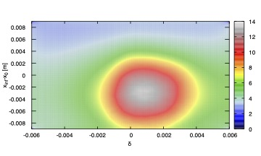
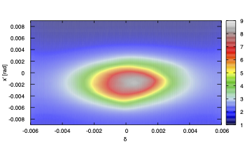
Track particles with temporal distribution as per measured T0 through the injection channel and into the ring
Peak kicker field is 204 G (Run 1), with measured kicker pulse shape
Offset and angle at inflector vs fractional momentum offset for particles that survive at least 4 us
config_019

Slide 10
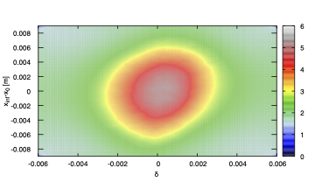
Track particles with temporal distribution as per measured T0 through the injection channel and into the ring
Peak kicker field is 284 G (Run 3), Measured kicker pulse shape
Offset and angle at inflector vs fractional momentum offset for particles that survive at least 4 us
  config_021

Slide 11
(Propagate Diktys’ distribution of 400k muons through injection line to inflector exit
Crnkovic et al. doc-db 3477

Slide 12
END

Slide 13
Re-cap
Assume uniform distribution of momenta in injected beam
Scan x_{inf} over inflector width (from 0.068m to 0.086m)
Use
Use measured kick pulse shape to get
Weight by measured pulse intensity and assume x is gaussian distributed
Run I
Time dependence of kicker field and injected pulse

Slide 14
Crnkovic et al. doc db 3477 and 3841 show that spin angle and muon phase space coordinates x, x’, are correlated in muons propagated to end of M5
If x, x’ are correlated with momentum acceptance, we expect early to late effect
doc db 3841

