Slide 1
Spin-phase space correlations and differential decay
D. Rubin
Cornell University
February 1, 2023

Slide 2
Correlations of spin phase with x, x’ and δ, in beam at g-2 ring are determined by Monte Carlo simulation
(Simulation that includes generation of pion beam, decay to muons, propagation around delivery ring to end of M5)
The correlations are small, and the precision is limited by statistics.
And we would like to massage Eremey’s distribution so that it matches our measured twiss parameters, etc.
- without altering those subtle correlations
It would be useful to have some analytic first principles estimate of the size of the correlations as a guide.

Slide 3
Correlation of spin phase with displacement (x), angle (x’) and momentum (δ=Δp/p) in distribution at the end of M5
Origin: Energy dependence of spin tune in delivery ring
Origin: π⁺ decay kinematics
EndofM5_Valetov_withInit.dat doc-db 17800

Slide 4
φ(x)
φ(x’)
x’(δ)
x(δ)
Nonlinear
π⁺ decay kinematics

Slide 5
x’(δ)
x(δ)
Since x and x’ are nonlinear functions of δ, and <δ> is a function of time, is also a function of time

Slide 6
Δω_{a} increases with time
Time averaged <Δω_{a}> also increases with time

Slide 7
Fractional change in ω_{α} due to spin-coordinate correlation
Caveat
Confirm that ‘theory’ gives upper limit on correlation at inflector exit by fixing BMAD code that transforms twiss parameters of raw distribution to match tuned values.
And/or – propagating raw distribution through injection channel without modification of twiss parameters and so preserving the imbedded correlation

Slide 9
β=9m
β=1m
β=9m
β=81m
β=81m
β=1m
β=9m

Slide 12
BMAD
GM2RINGSIM

Slide 13
1 264G-210ns-Raw
2 Inf-1%
3 Inf+1%
4 224G-180ns
5 264G-180ns
6 264G-210ns
7 264G-210ns-Diktys
8 gm2rinsim-Run_2
9 gm2rinsim-Run_3a
10 gm2rinsim-Run_3b
11 gm2rinsim-Raw

Slide 14




p_{μ}
μ⁺
μ⁺
s'
s
φ
P’_{μ}
x'
z
π⁺
Boost to lab frame
π⁺
ν_{μ}
Pion rest frame
Suppose pion beam has zero emittance
At birth, x=0, x’=x’₀
=>
Where
are twiss parameters
Is the angle of the muon with respect to
Is β-function at pion decay point
Is velocity of the muon in the pion rest frame

Slide 15
If
Pion beam has zero emittance
all along pion decay channel
With turns around the Delivery Ring φ regresses by the same amount independent of amplitude a

Slide 16
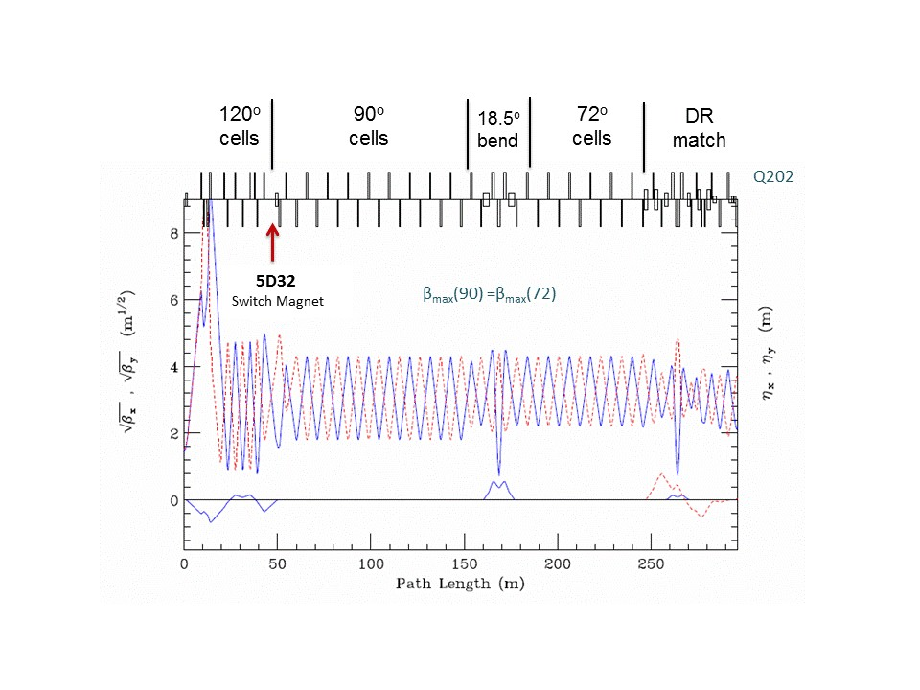
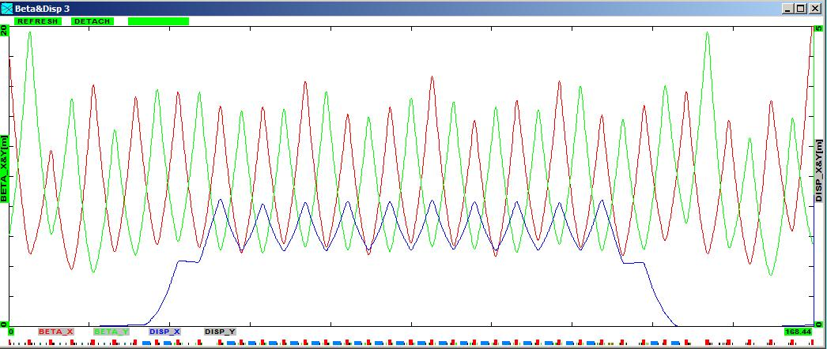
2.6e-8*22*3.e8=
P decay length 171m
Stratakis 3926

Slide 19
x_{b}'
x_{a}'

Slide 20


